Slide 1
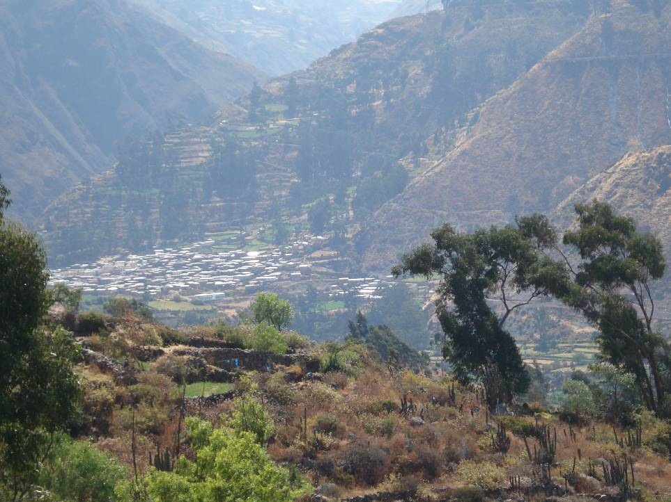
The Social-ecological systems meta-analysis database (SESMAD) project
Notes:
1

Slide 2
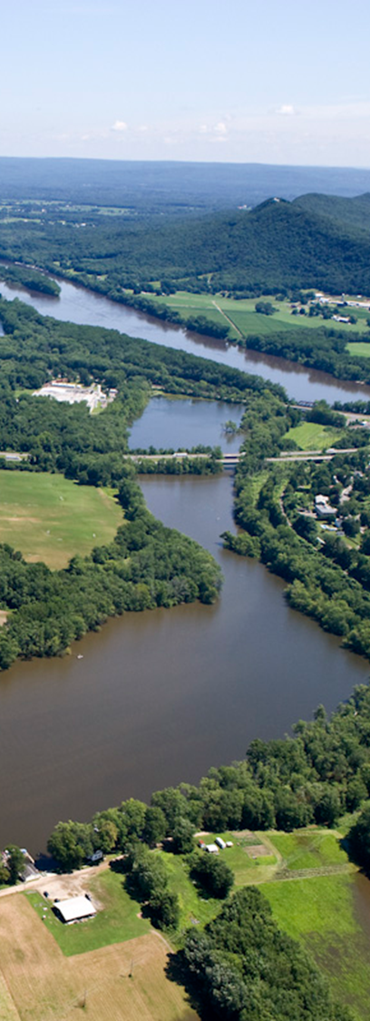
Members
Michael Cox | Dartmouth College, USA
Mike Schoon | Arizona State University, USA
Natalie Ban | University of British Columbia, Canada
Chanda Meek | University of Alaska Fairbanks, USA
Forrest Fleischman | U. of Minnesota, USA
Gustavo Garcia-Lopez | University of Puerto Rico
Brent Loken | Simon Fraser University, Canada
Frank van Laerhoven | Utrecht University, Netherlands
Graham Epstein | U. of Waterloo, USA
Irene Perez Ibarra | Arizona State University, USA
Louisa Evans | U. of East Anglia, Australia
Mateja Nenadovic | Duke University, USA
Andreas Thiel | Kassel University, Germany
Sergio Villamayor | ICTA, Spain
Notes:
2

Slide 3
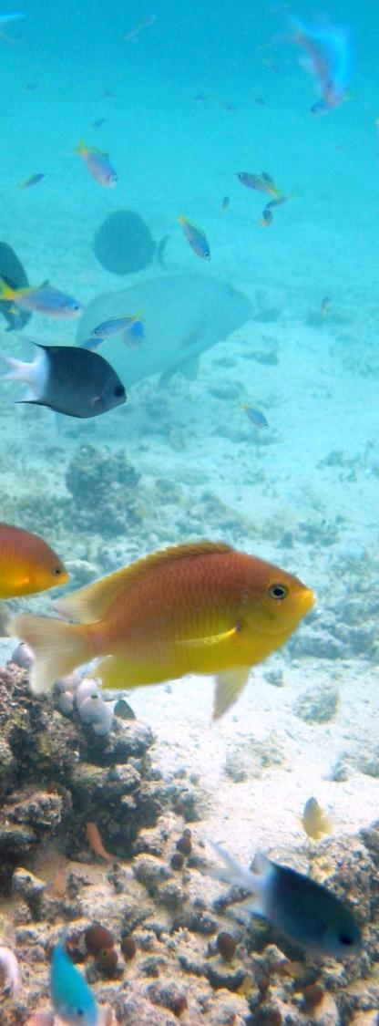
The problem
Scholars of commons have discovered far more variables that potentially affect resource management than is possible to analyze carefully… how can research be conducted in a cumulative and rigorous fashion if this many variables need to be identified in every study?”
(Agrawal 2003)
→ Many case studies of environmental governance have been conducted, but with inconsistent protocols, which are not easily comparable
Notes:
3
Many case studies of environmental governance have been conducted, but with inconsistent protocols, these are not easily comparable
Collecting data comparably from the start would impose extremely high coordination costs

Slide 4
Approach
Based on:
CPR meta-analysis project; IFRI research project
Social-ecological systems framework
Relational database with approximately 200 variables
Protocol: Extract data via content analysis from studies to measure values of these variables for a set of cases
Modeling the system: SES components
Recording variable values
Repository of interlinked cases, studies and theories
Notes:
4

Slide 5
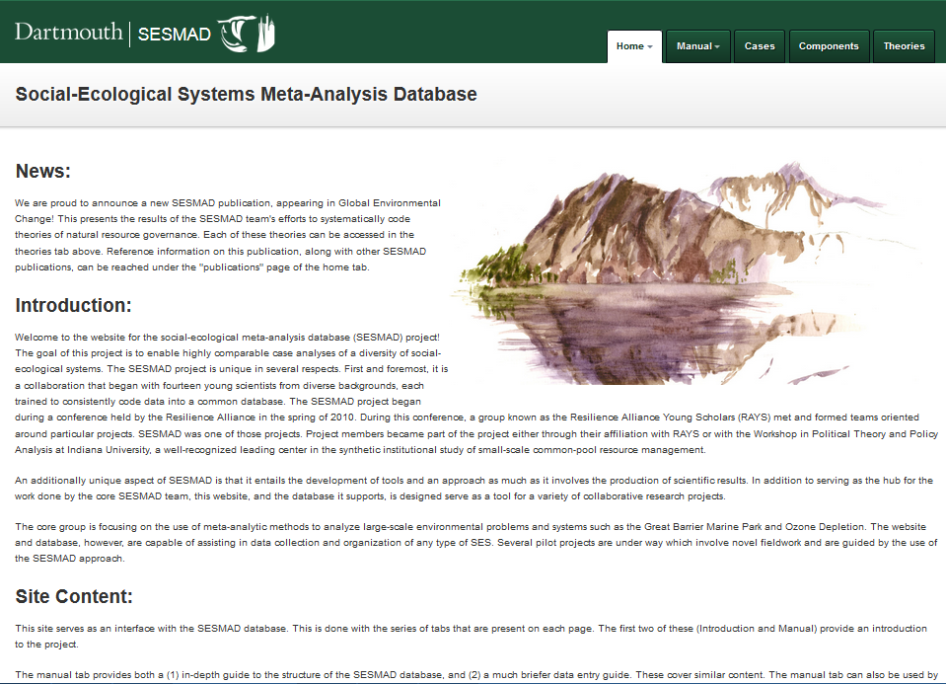
Approach
https://sesmad.dartmouth.edu/pages/intro
Notes:
5

Slide 6
SESMAD projects
CPR scaling up
Cox, M., (2014), Understanding large social-ecological systems: introducing the SESMAD project, (see Special Issue, International Journal of the Commons, Vol. 8).
Marine protected areas
Ban, N. C., T. E. Davies, S. E. Aguilera, C. Brooks, M. Cox, G. Epstein, et al. (2017), Social and ecological effectiveness of large marine protected areas, Global Environmental Change, 43, 82-91.
Small scale fisheries in Fiji
Jupiter, S. D., G. Epstein, N. C. Ban, S. Mangubhai, M. Fox, and M. Cox (2017), A Social–Ecological Systems Approach to Assessing Conservation and Fisheries Outcomes in Fijian Locally Managed Marine Areas, Society & Natural Resources, 1-16.
Theories in social-environmental science
Cox, M., S. Villamayor-Tomas, G. Epstein, L. Evans, N. C. Ban, F. Fleischman, et al. (2016), Synthesizing theories of natural resource management & governance, Global Environmental Change, 39, 45-56.
Notes:
6

Slide 7
Interested?
Contact
Michael Cox: Michael.e.cox@dartmouth.edu
Notes:
7

