Slide 1
Exclusion and control in Mexican ejido reforms
Gustavo Gordillo
IASC
Utrecht, July 2017

Slide 2
THE RURAL STRONGHOLD
In the XX c 11 states
concentrate between 68% y 71% of rural population

Slide 3
HISTORICAL BACKGROUND OF THE AGRARIAN REFORM PROCESS

Slide 4
WHAT IS THE EJIDO
RURAL COMMUNITIES:
URBAN PLOT
PLUS
INDIVIDUAL PARCEL
PLUS
COMMON RESOURCES

Slide 5
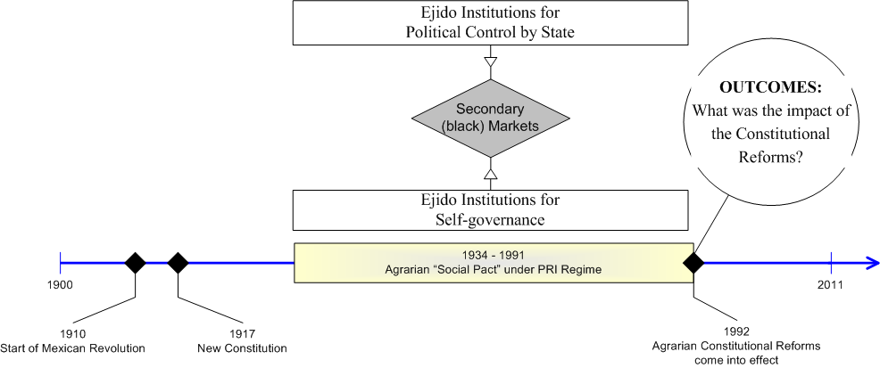
THE EJIDO: TWO FACETS

Slide 6
THE EJIDO BEFORE 1991
URBAN PLOT NORMAL PRIVATE PROPERTY
PARCELS PRIVATE USUS FRUCTUS
COMMON LAND COLLECTIVE USUS FRUCTUS

Slide 7
EJIDO RULES (BEFORE 1991)
Work the land directly;
Could not hire wage labour.
Could not rent the land or sell it.
Absences from the ejido led to loss of right to the land.
Ejidatarios could vote for and be elected to the Executive Committee of the ejido's Assembly.
Executive Committee automatically membership to the PRI.
MEXICO A ONE PARTY REGIME FROM 1929 UNTIL 1997-2000

Slide 8
STATE INTERVENTIONS
Access to land could be gained in one of four ways: donation thru expropiation, restitution,extension, new lands.
In the internal life of ejidos
In arbitration
In controlling the flow of public resources to the ejido (credit, trading boards and guarantee prices, fertilizers,technical assistance, irrigation,social welfare and infrastructure)

Slide 9
THE REFORM PACKAGE
End to land redistribution
The three forms of property enshrined in the Constitution: private,ejido and indigenous land
For the ejido and its three components, an array of options: full property,condominium, rent, sharecropping, joint-ventures
Self governed assemblies
Land cadaster and registration to give titles to all ejidatarios
Ombudsman to attend conflicts
Special agrarian courts

Slide 10
THE EJIDO AFTER 1991
URBAN PLOT NORMAL
PRIVATE PROPERTY
PARCEL AS FARMER DECIDES FROM USUS FRUCTUS TO FULL PRIVATE PROPERTY
COMMON LAND
CONDOMINIUM PROPERTY

Slide 11
EJIDO RULES (WITH REFORM)
Work the land directly; ELIMINATED
Could not hire wage labour. ELIMINATED
Could not rent the land or sell it. ELIMINATED
Absences from the ejido led to loss of right to the land. ELIMINATED
Order of heirs to their land in writing, usually naming a spouse or partner as the preferred successor. ELIMINATED
Ejidatarios could vote for and be elected to the Executive Committee of the ejido's Assembly. ELIMINATED
Executive Committee automatically membership to the PRI. ELIMINATED

Slide 12
RESULTS:TITLING AND LAND MARKETS
Out of 32,047 ejidos, 30,319 ejidos and more than 95 million hectares, have been measured and titled during the period (1994-2015).
About 10 per cent of the ejidos with less than 5 per cent of the ejido certified land have chosen the alternative of potential privatization of their parcels. (RAN,2015)
23,612 ejidos have reported operations of selling and buying of parcels within the ejido to other ejidatarios and neighbors involving one million parcels, 677,000 ejidatarios and 17 millions hectares.(RAN, 2017)
¿Leasing markets?

Slide 13
RESULTS(2)
The national average size of the plots –has been reduced from 9.1 hectares to 7.5 hectares, which might suggest that consolidation of bigger parcels thru buying and selling of land has been offset by intra-family subdivisions of plots.

Slide 14
GOVERNANCE OF THE COUNTRYSIDE
THE AUTHORITARIAN TRIANGLE
THE PRESIDENCY ON THE APEX.
THE MINISTRY OF AGRARIAN REFORM AS THE MINISTRY OF POLITICAL CONTROL IN THE COUNTRYSIDE
THE MAIN CORPORATIST UNION –CNC- AS THE INTELLIGENCE NETWORK

Slide 15
THE BREAKDOWN OF THE RURAL GOVERNANCE
WHAT HAPPENED TO THE PRESIDENCY IN RELATION TO THE COUNTRY SIDE
WHAT HAPPENES TO THE MINISTRY OF AGRARIAN REFORM
WHAT HAPPENED WITH THE CORPORATIST ORGANIZATIONS

Slide 16
RESPONSE STRATEGIES (1)
Farmers modernizing agriculture access to water bigger extension of land combining corn with fruits and vegetables,
Farmers that diversify activities thru complex agriculture and cattle combinations,
Farmers that diversify income thru off farm activities via wages and remittances.

Slide 17
RESPONSE STRATEGIES (2)
Peasants which basic source of income is public funds,
Peasants disconnecting from markets and developing almost autarchic livelihoods,
Neighbors living in the ejido community with limited rights over the ejido lands ( an average of 85 neighbors per ejido versus 95 as full members) following mixed strategies.

Slide 18
RESPONSE STRATEGIES
Migration domestic and international. Role of remittances
Illegal activities

Slide 19
THE EJIDO PROJECT
Hypotheses
The certification process by reducing agrarian conflicts creates a new potential for governability in the countryside.
Although changes in the internal governance of the ejidos have gained more autonomy to make decisions, the emergence of new black markets in economic and political aspects generates forms of corruption and clientelism.
The absence of gubernmental agencies oriented towards deliverying public goods –from public security to technical assistance and economic promotion has caused a crisis of gobernability

Slide 20
THE EJIDO PROJECT (2)
The low levels of governance translates in to increased criminals actions in the countryside, reduces the impact of anti-poverty programs and weakens more the social cohesion of communities.

Slide 21
THE EJIDO PROJECT
THE WAY FORWARD
Analyzing thru interviews to ejidatarios and comuneros the way they have adapted to changes that came about with the rural reforms of 1991-1992. Our goal is 300 interviews in a sample of ejidos in the 31 states of Mexico (2016-2018).
10 case studies based on a territorial approach on links political, social and economic amongst ejidos, between ejidos and other actors and interplay urban-rural. (2018)
Develop and continuously update an informatic plataform open to the public that links different databases produced by government agencies, international agencies and private companies on the ejido. (2016-2018)

Slide 22
THANK YOU!
gusto.gustavo@gmail.com
twitter @gusto47
http://gustavogordillo.blogspot.com/

