Slide 1
USAID’S EVALUATION OF NAMATI’S COMMUNITY LAND PROTECTION PROGRAM (2014-2017)
USAID
Caleb Stevens and Sarah Lowery
USAID Office of Land and Urban
Kate Marple-Cantrell
The Cloudburst Group
IASC Conference July 2017

Slide 2
AGENDA
INTRODUCTION
COMMUNITY LAND PROTECTION PROGRAM
IMPACT EVALAUTION METHODS
PRELIMINARY FINDINGS
NEXT STEPS

Slide 3
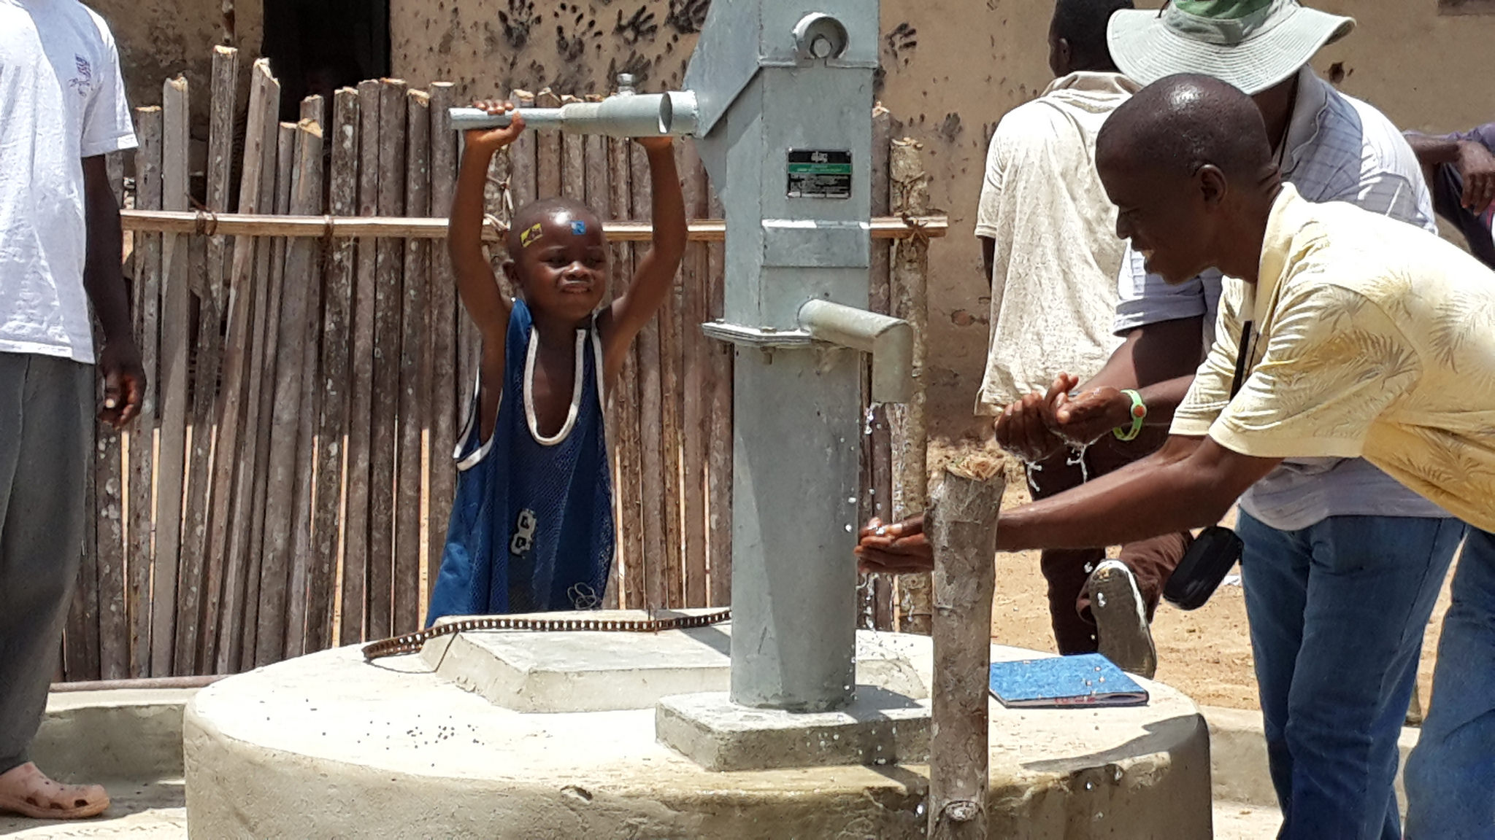
INTRODUCTION
USAID

Slide 4
INTRODUCTION
Current wave of strengthening land tenure: formal recognition of customary systems
Rights-based argument for formal recognition of customary tenure is widely accepted but instrumentalist argument less clear (e.g. Lawry et al 2014 finds this “major blind spot”)
Land in customary tenure systems is substantial:
Formal recognition of customary tenure: Mozambique’s 1997 Land Law and Tanzania’s 1999 Village Lands Act
Country | Amount of Land under Customary Tenure
Kenya | 70% of rural land
Gambia | 9,084 square kilometers [80% of total land]
Ghana | 80% of land area
Zambia | 94% of land are “customary areas”
Ethiopia | 56% of land area under customary pastoral land
Malawi | >80% of land area
Mauritania | 85% of land area
Sierra Leone | 95% of land area
Uganda | 80% of the land area
Notes:
Kenya, Uganda, Liberia, South Sudan, Malawi and Zambia have or will follow suit

Slide 5
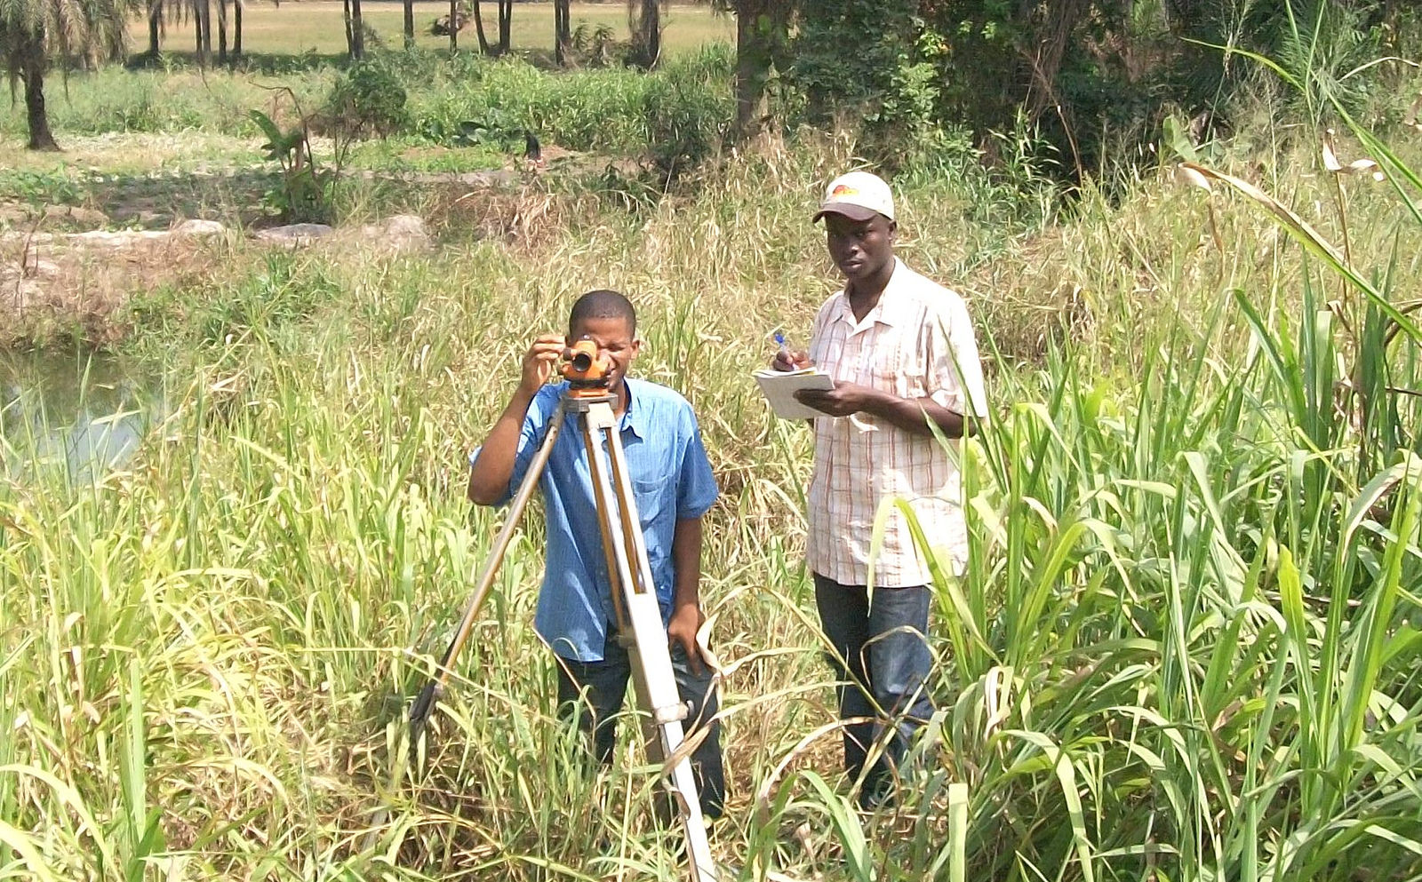
Community land protection program
USAID

Slide 6
COMMUNITY LAND PROTECTION PROGRAM (CLPP)
Integrated community land protection model that supports communities to protect their lands and natural resources in 5 program stages:
  Laying the groundwork;
  Strengthening community governance (including bylaw drafting);
  Harmonizing boundaries and documenting lands (including boundary mapping and MOU signing with neighboring communities);
  Pursuing legal recognition; and
  Preparing communities to prosper
In 2009 Namati and Sustainable Development Initiative approached Liberian Land Commission and requested permission to pilot innovative community land documentation process in 20 communities in River Cess County (which then showed promising results)
Notes:
Laying the ground work: (1) Shared community vision; (2) estimation of value of use; (3) legal education about land rights
Strengthening governance: (1) establishment of community land administration and natural resources management bylaws; (2) development of land use plans; (3) creation of local governance body with participation of community
Harmonizing boundaries etc.: (1) community “sketch mapping” of land and resources; (2) boundary harmonization and conflict resolution with neighboring clans; (3) boundary demarcation, including GPS mapping of community lands

Slide 7
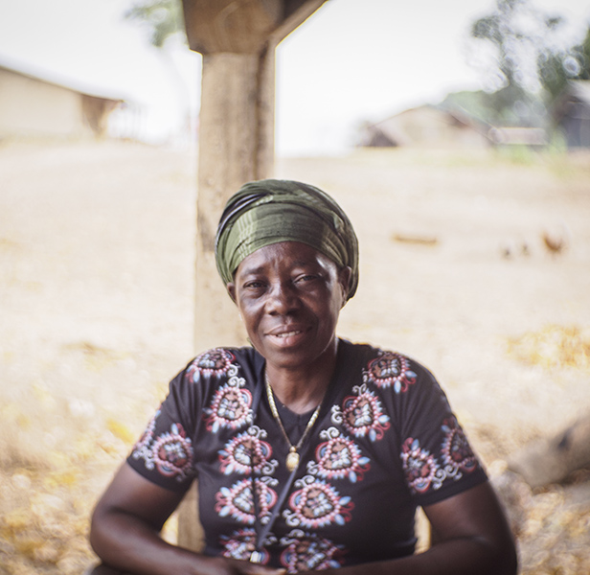
WHAT WE EXPECT TO LEARN
Did CLPP…
  Improve community tenure security?
  Increase accountability of community leaders?
  Increase protection for women’s land rights and minority groups?
  Increase participation of women’s empowerment and participation within the community?
  Increase social cohesion?
  Reduce incidence of expropriation of community land without consent or compensation?
Ben Ewing / Cloudburst
Notes:
Need more and better evidence rather than working from widely-held assumptions or beliefs

Slide 8

IMPACT EVALUATION METHODS

Slide 9
OVERVIEW – CLPP EVALUATION METHODS
Mixed methods evaluation that combines qualitative and quantitative data sources
Presence of control group allows evaluation to detect changes and attribute them to CLPP
Baseline data collected February–July 2014; Midline data collected February–March 2017
Two types of primary quantitative indicator analysis:
  Cross-sectional (midline only) fixed effects linear models to test whether treatment status predicts midline-only household-level outcome variables (N 818).
  Fixed effects Difference-in-Difference (DID) model to determine program impacts on panel household-level outcome variables (N 683).

Slide 10
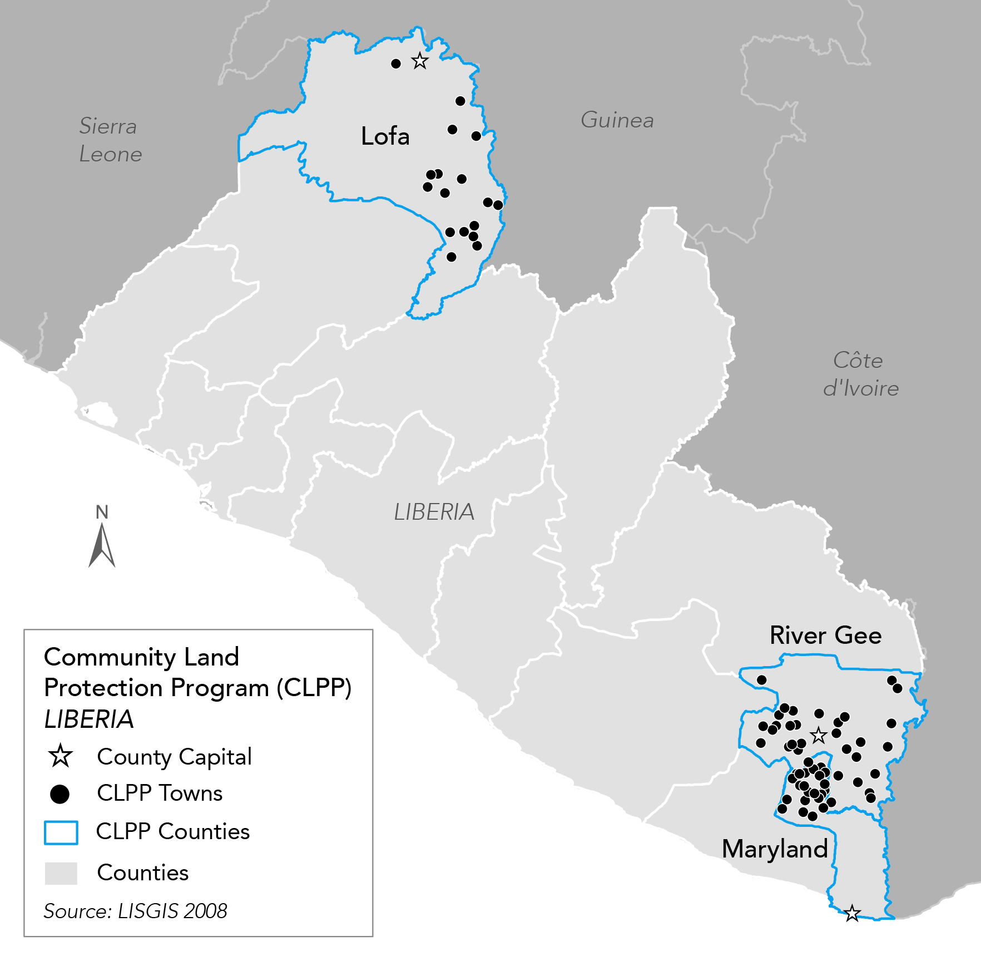
CLPP MIDLINE
METHODS
Data collected from same communities and households as baseline
  57 communities
  Household survey of 818 respondents
  Leader survey of 162 respondents (3 per community)
  162 Focus Group Discussions (3 per community)
Geospatial data used to select control sites
Notes:
Leaders involved in land decisions, including the Town Chief and traditional leaders (elders, landlord, Quarter Chief, Paramount Chief). Technically the Town Chief is a 'hybrid' figure because they have ties to both traditional structures and the central Liberian government.

Slide 11
DATA SOURCES
Household survey— Approx. 45 min.; Based on a random sample of households selected from each community; same households at baseline and endline
  Key instrument for examining treatment effects for women and vulnerable groups
Leader survey—Approx. 45 min.; Close-ended survey interview with a select number of leaders in each community
  Leaders are town chief, women, youth, and minority leaders, where applicable
  Means to measure community level processes and outcomes (land conflict, community land tenure security)
Focus group discussions—Approx. 60 min.
  With women and youth, as well as other groups of interest including minorities and elders
Key Informant Interviews—Approx. 15 min.; Immediately follows quantitative Leader Surveys
  Elaborate on community level processes and outcomes as well as provide detailed information about relationship between local leaders and regional/national government officials

Slide 12
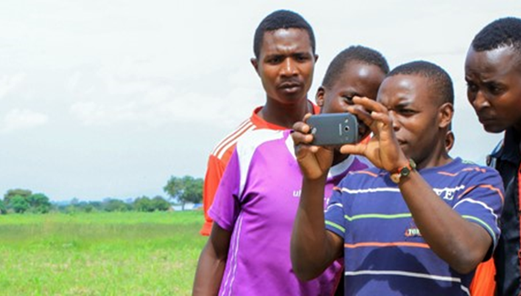
USAID
PRELIMINARY FINDINGS

Slide 13
CLPP Progress
Integrated community land protection model that supports communities to protect their lands and natural resources in 5 program stages:
  Laying the groundwork – 91% of treatment communities have completed
  Strengthening community governance (including bylaw drafting) – 91% of treatment communities have started drafting bylaws (but none have adopted them nor have elected land management committees)
  Harmonizing boundaries and documenting lands (including boundary mapping and MOU signing with neighboring communities) – all treatment communities have completed sketchmaps and 59% have begun boundary negotiations with neighboring clans
Notes:
Our findings focus on the effects of the first intervention and the more limited progress made on the other treatment components

Slide 14
FINDINGS: TENURE SECURITY
Households in CLPP-supported communities:
  Experienced slight, significant increase in likelihood of loss of access to communal farmland; and
  Report no change overall in perceived risk of encroachment on communal land but are more likely to report risk of encroachment by neighboring households.
Distance to concessions influences perceived tenure security:
  Households farther from concessions are significantly more likely to have better perceived tenure security, but magnitude of effect is small (approximately 5%)
Notes:
First finding: Perhaps due to the program reviving discussion of dormant land disputes

Slide 15
FINDINGS: GOVERNANCE
Households in CLPP-supported communities:
  Are more likely to report that the decisions their leaders make about land use and access are fair;
  Believe their leaders have greater ability to protect their forests;
  Have higher satisfaction with leaders;
  Report more ethical behavior in their leaders, as measured by the likelihood of their taking bribes and by the likelihood of their acting in secret without the involvement of the community;
  Are consulted more often by leaders in land decision-making; and
  Participate more in creating land rules.
Notes:
The questions about leaders are asking about any local leaders involved in land decisions, including the Town Chief and traditional leaders (elders, landlord, Quarter Chief, Paramount Chief). Technically the Town Chief is a 'hybrid' figure because they have ties to both traditional structures and the central Liberian government. These questions would also include theoretically include the elected Land Management Committee at endline (which is a product of the CLPP intervention), but per SDI none of the communities have yet reached that milestone in the governance stage of the program.

Slide 16
KEY MESSAGES
CLPP is significantly associated with improved local land governance
BUT the program effect on tenure security (at midline) is mixed
  Treatment effect (receiving the CLPP intervention) is positive in some instances and negative in others

Slide 17
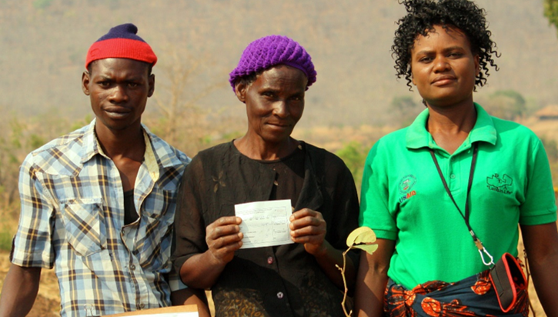
USAID
NEXT STEPS

Slide 18
NEXT STEPS
Analysis ongoing on the other primary tenure security and land governance indicators and on the full set of indicators
Will include analysis of differential impacts for key subgroups of interest (women, youth, members of minority groups)
Other indicators include:
  Incidence of land conflicts
  Community empowerment in negotiations with investors
  Natural resource condition, conservation, and community investment
Midline report will be completed this Fall 2017
Endline data collection anticipated in the next 2-3 years

Slide 19
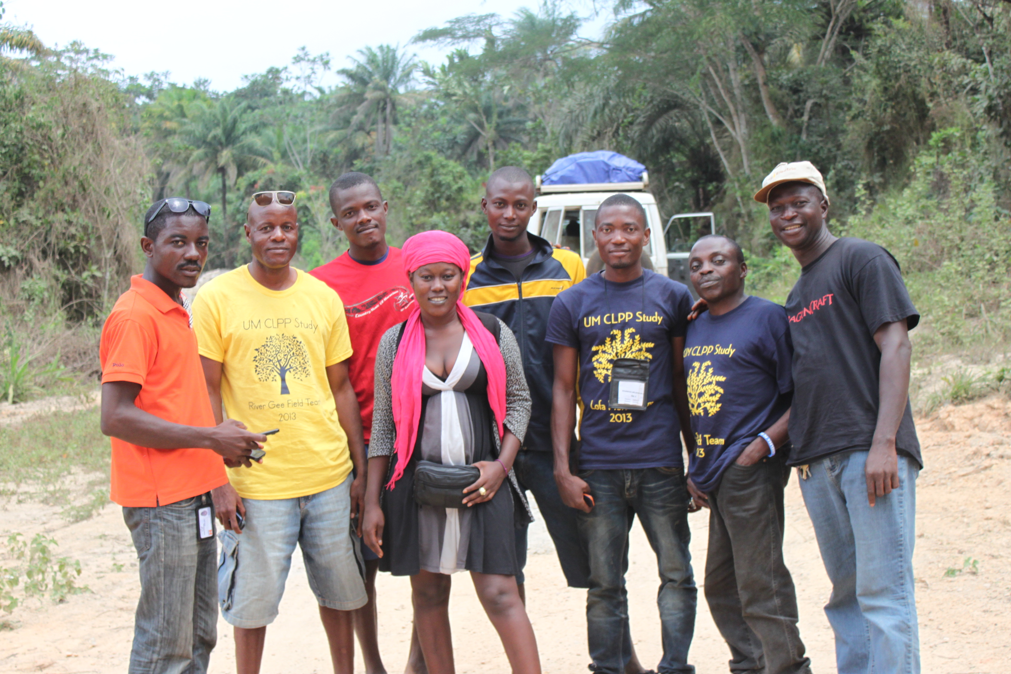
Karen Azeez / Cloudburst
THANK YOU
https://www.land-links.org/

