Slide 1
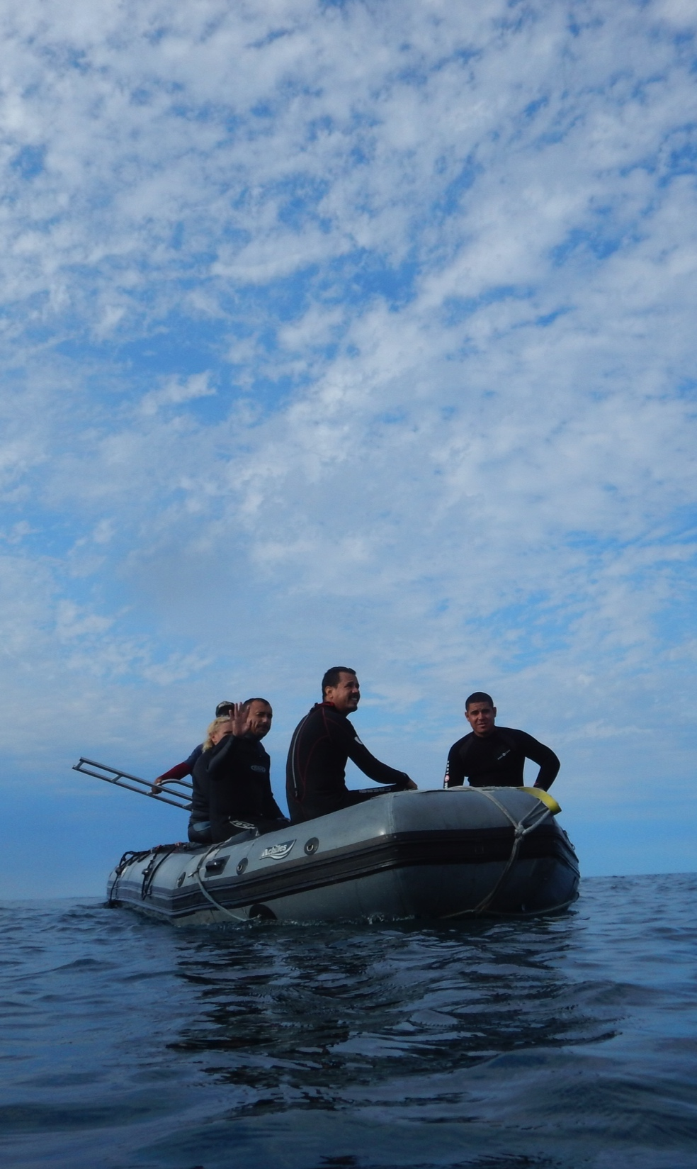
Anastasia
Quintana
PhD Student
Duke University
acq@duke.edu

Slide 2
Local Ecological Knowledge, participation, and legitimacy
Effects of an ecological monitoring program
in a Mexican
small-scale fishery

Slide 3
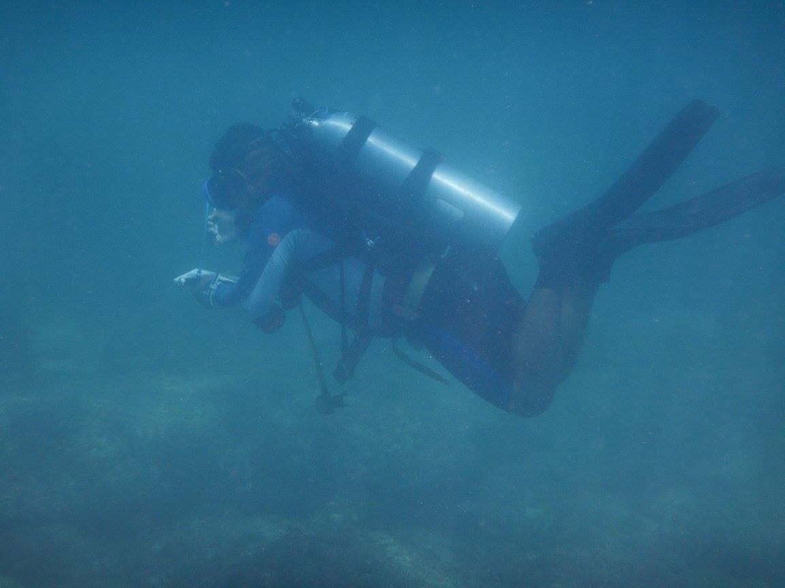

Slide 4
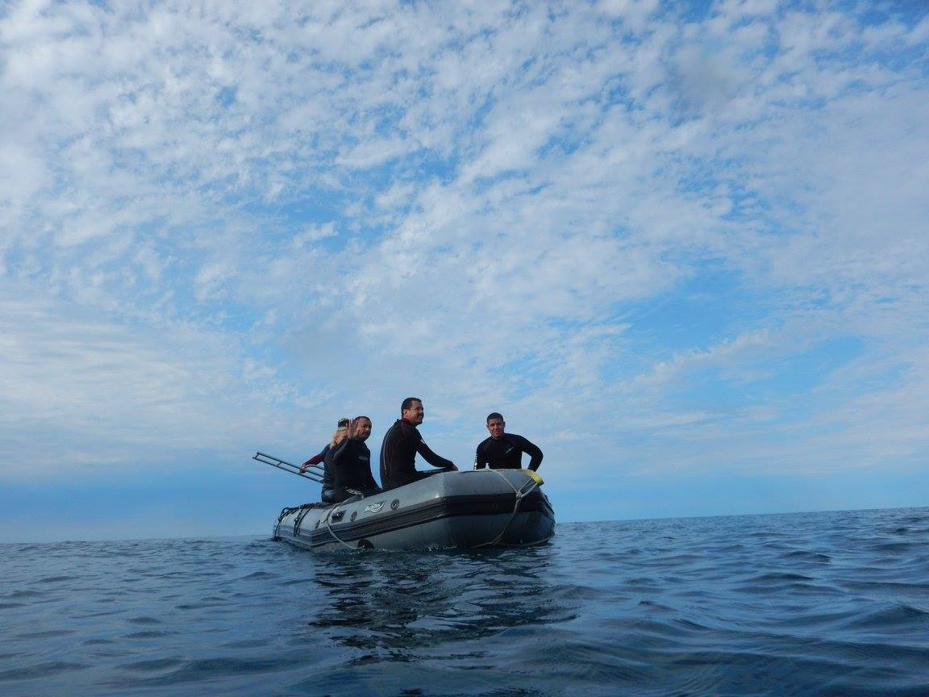
los
Buzos Monitores

Slide 5
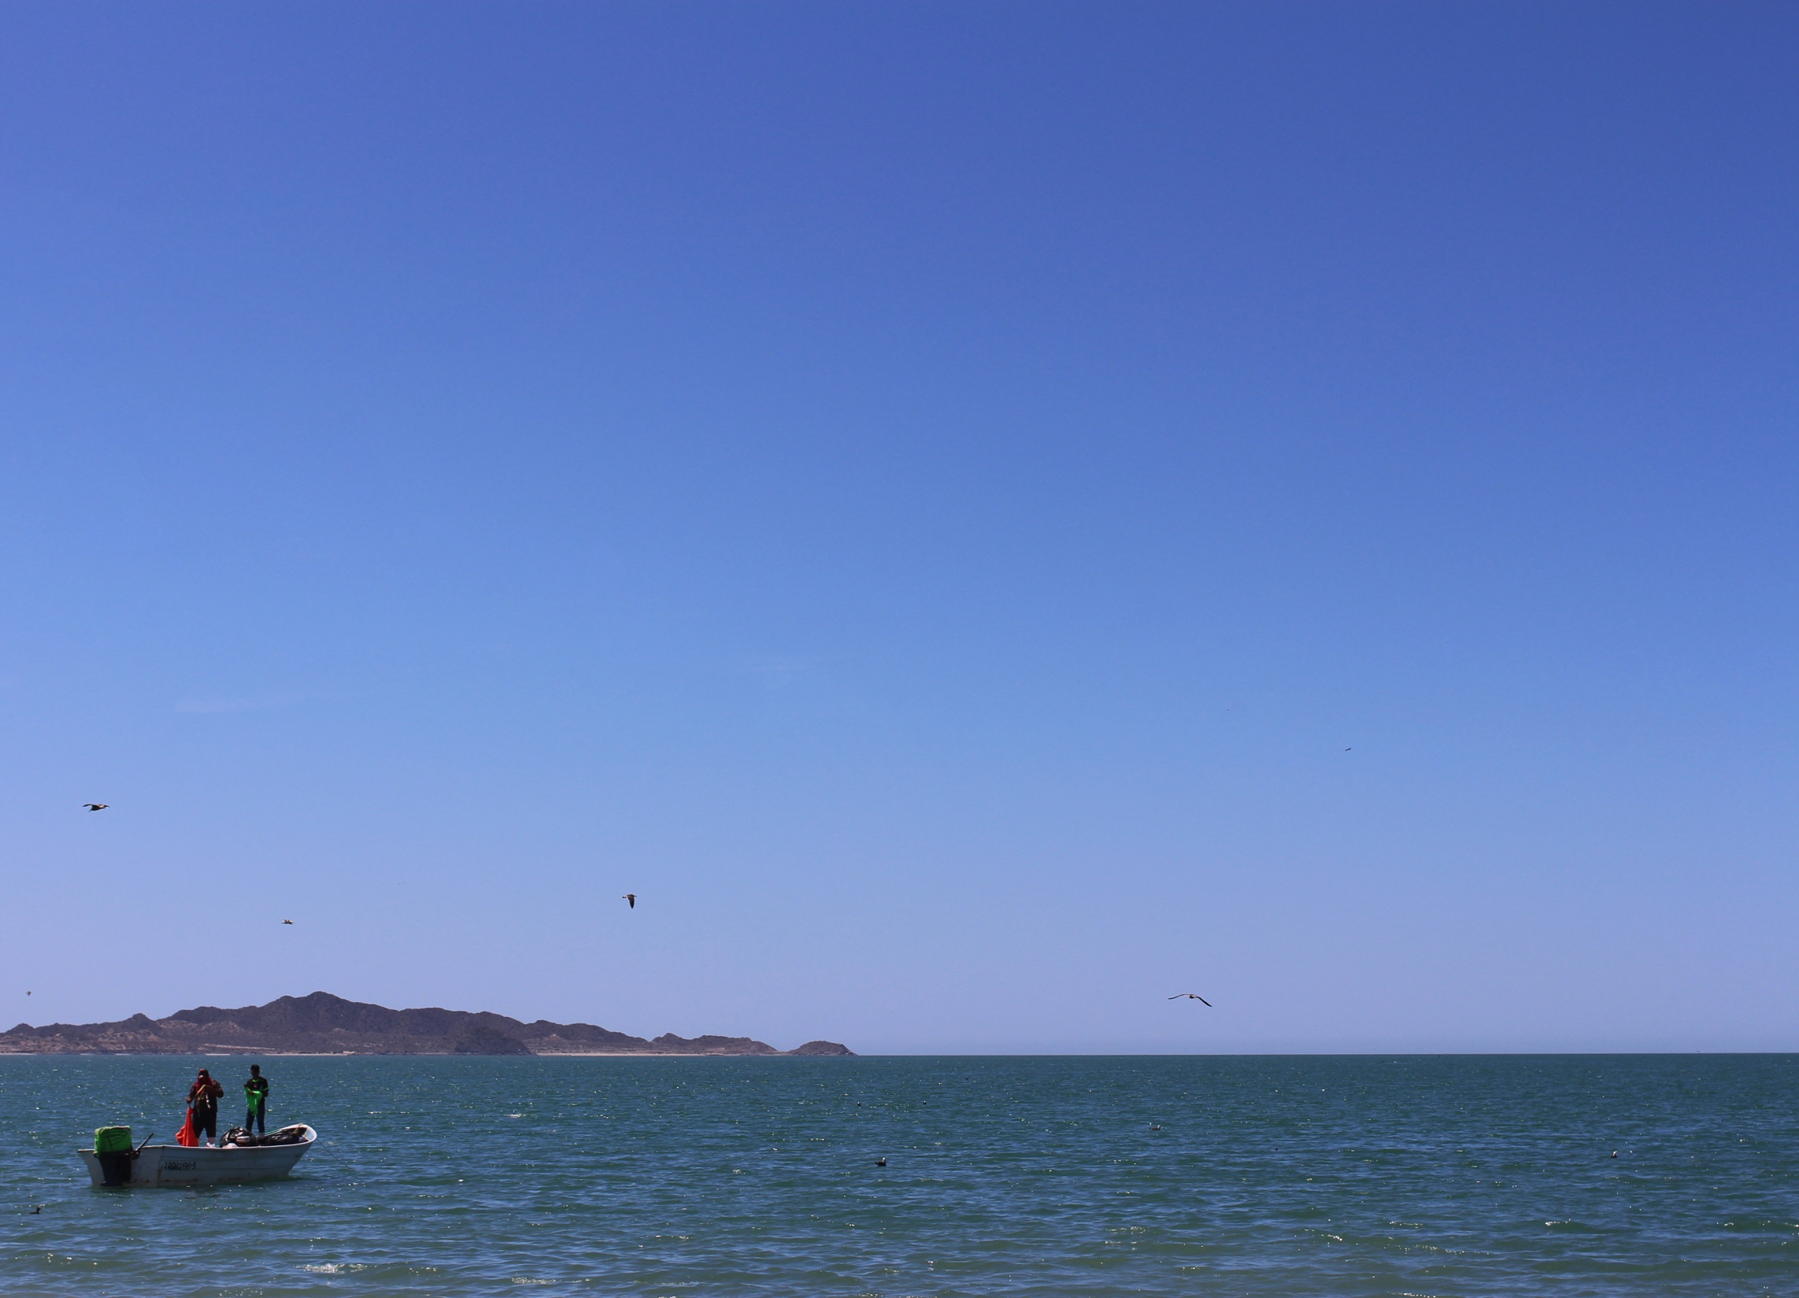
Outline
Theoretical
foundation
Research
question
Methods
Findings and
discussion

Slide 6
Theoretical
foundation
Research
question
Findings and
discussion
Methods

Slide 7
Resource governance frameworks
Institutional Analysis and Design Framework
(IAD Framework - Ostrom 2005)
Social-Ecological System Framework
(SES Framework - Ostrom 2007)
Theoretical
foundation
Research
question
Findings and
discussion
Methods

Slide 8
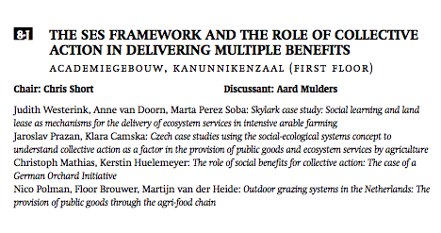
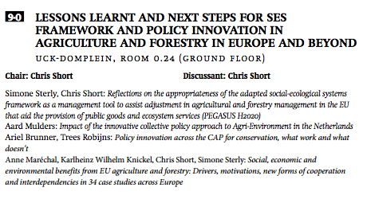
Resource governance frameworks
we dnE S day, july 12 – slot 9 – 14:00-15:30
Wednesday, 14:00-15:30
Wednesday, 11:00-12:30
Theoretical
foundation
Research
question
Findings and
discussion
Methods

Slide 9
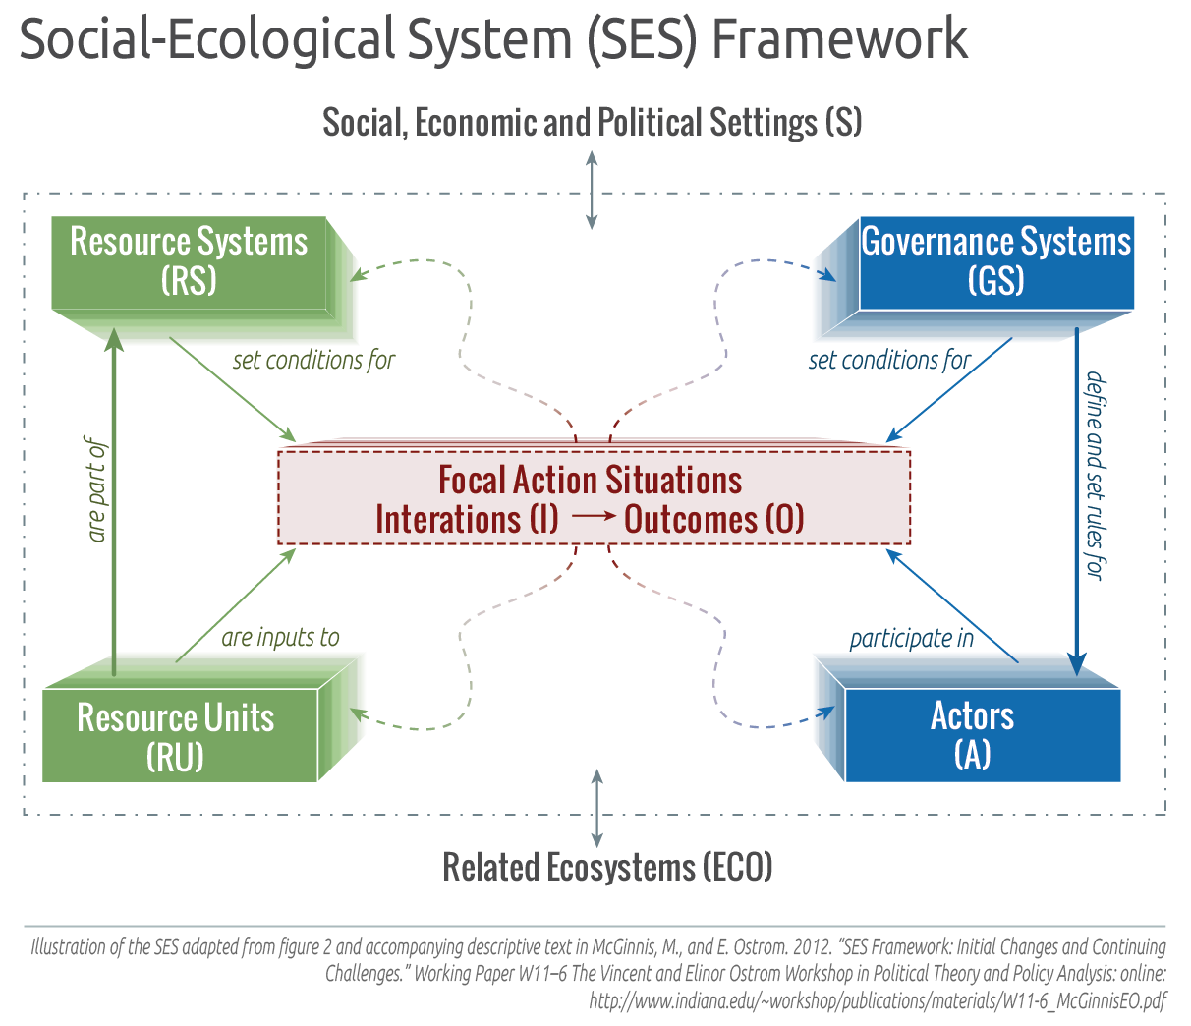

Slide 10
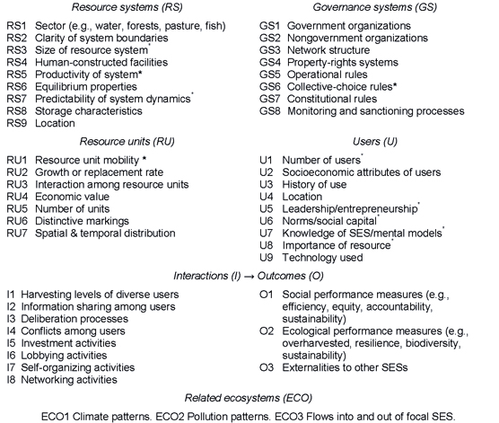

Slide 11
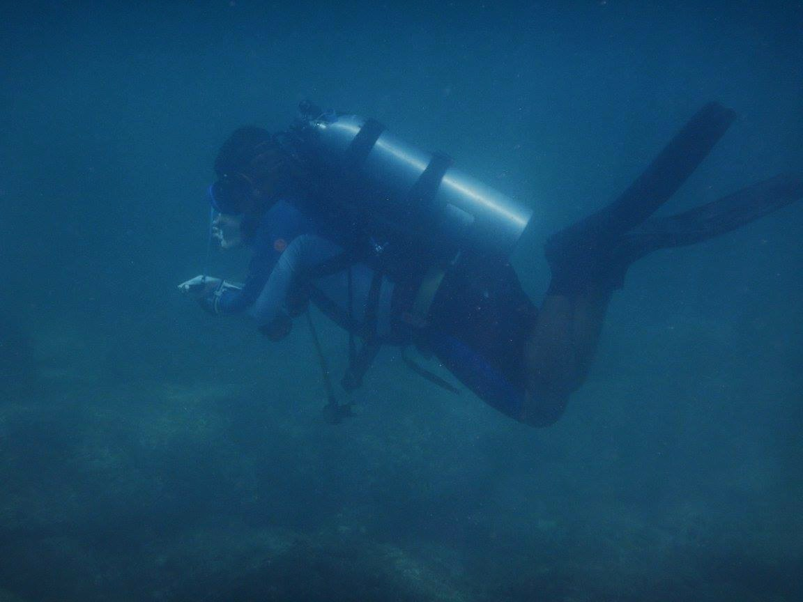
Ecological information?

Slide 13
Resource governance frameworks depoliticize information
Judith Floor, ecological information in the Wadden Sea
Theoretical
foundation
Research
question
Findings and
discussion
Methods

Slide 14
Resource governance frameworks depoliticize information
Judith Floor, ecological information in the Wadden Sea
Incomplete knowledge
Variability and unpredictability
Knowing differently
Theoretical
foundation
Research
question
Findings and
discussion
Methods

Slide 15
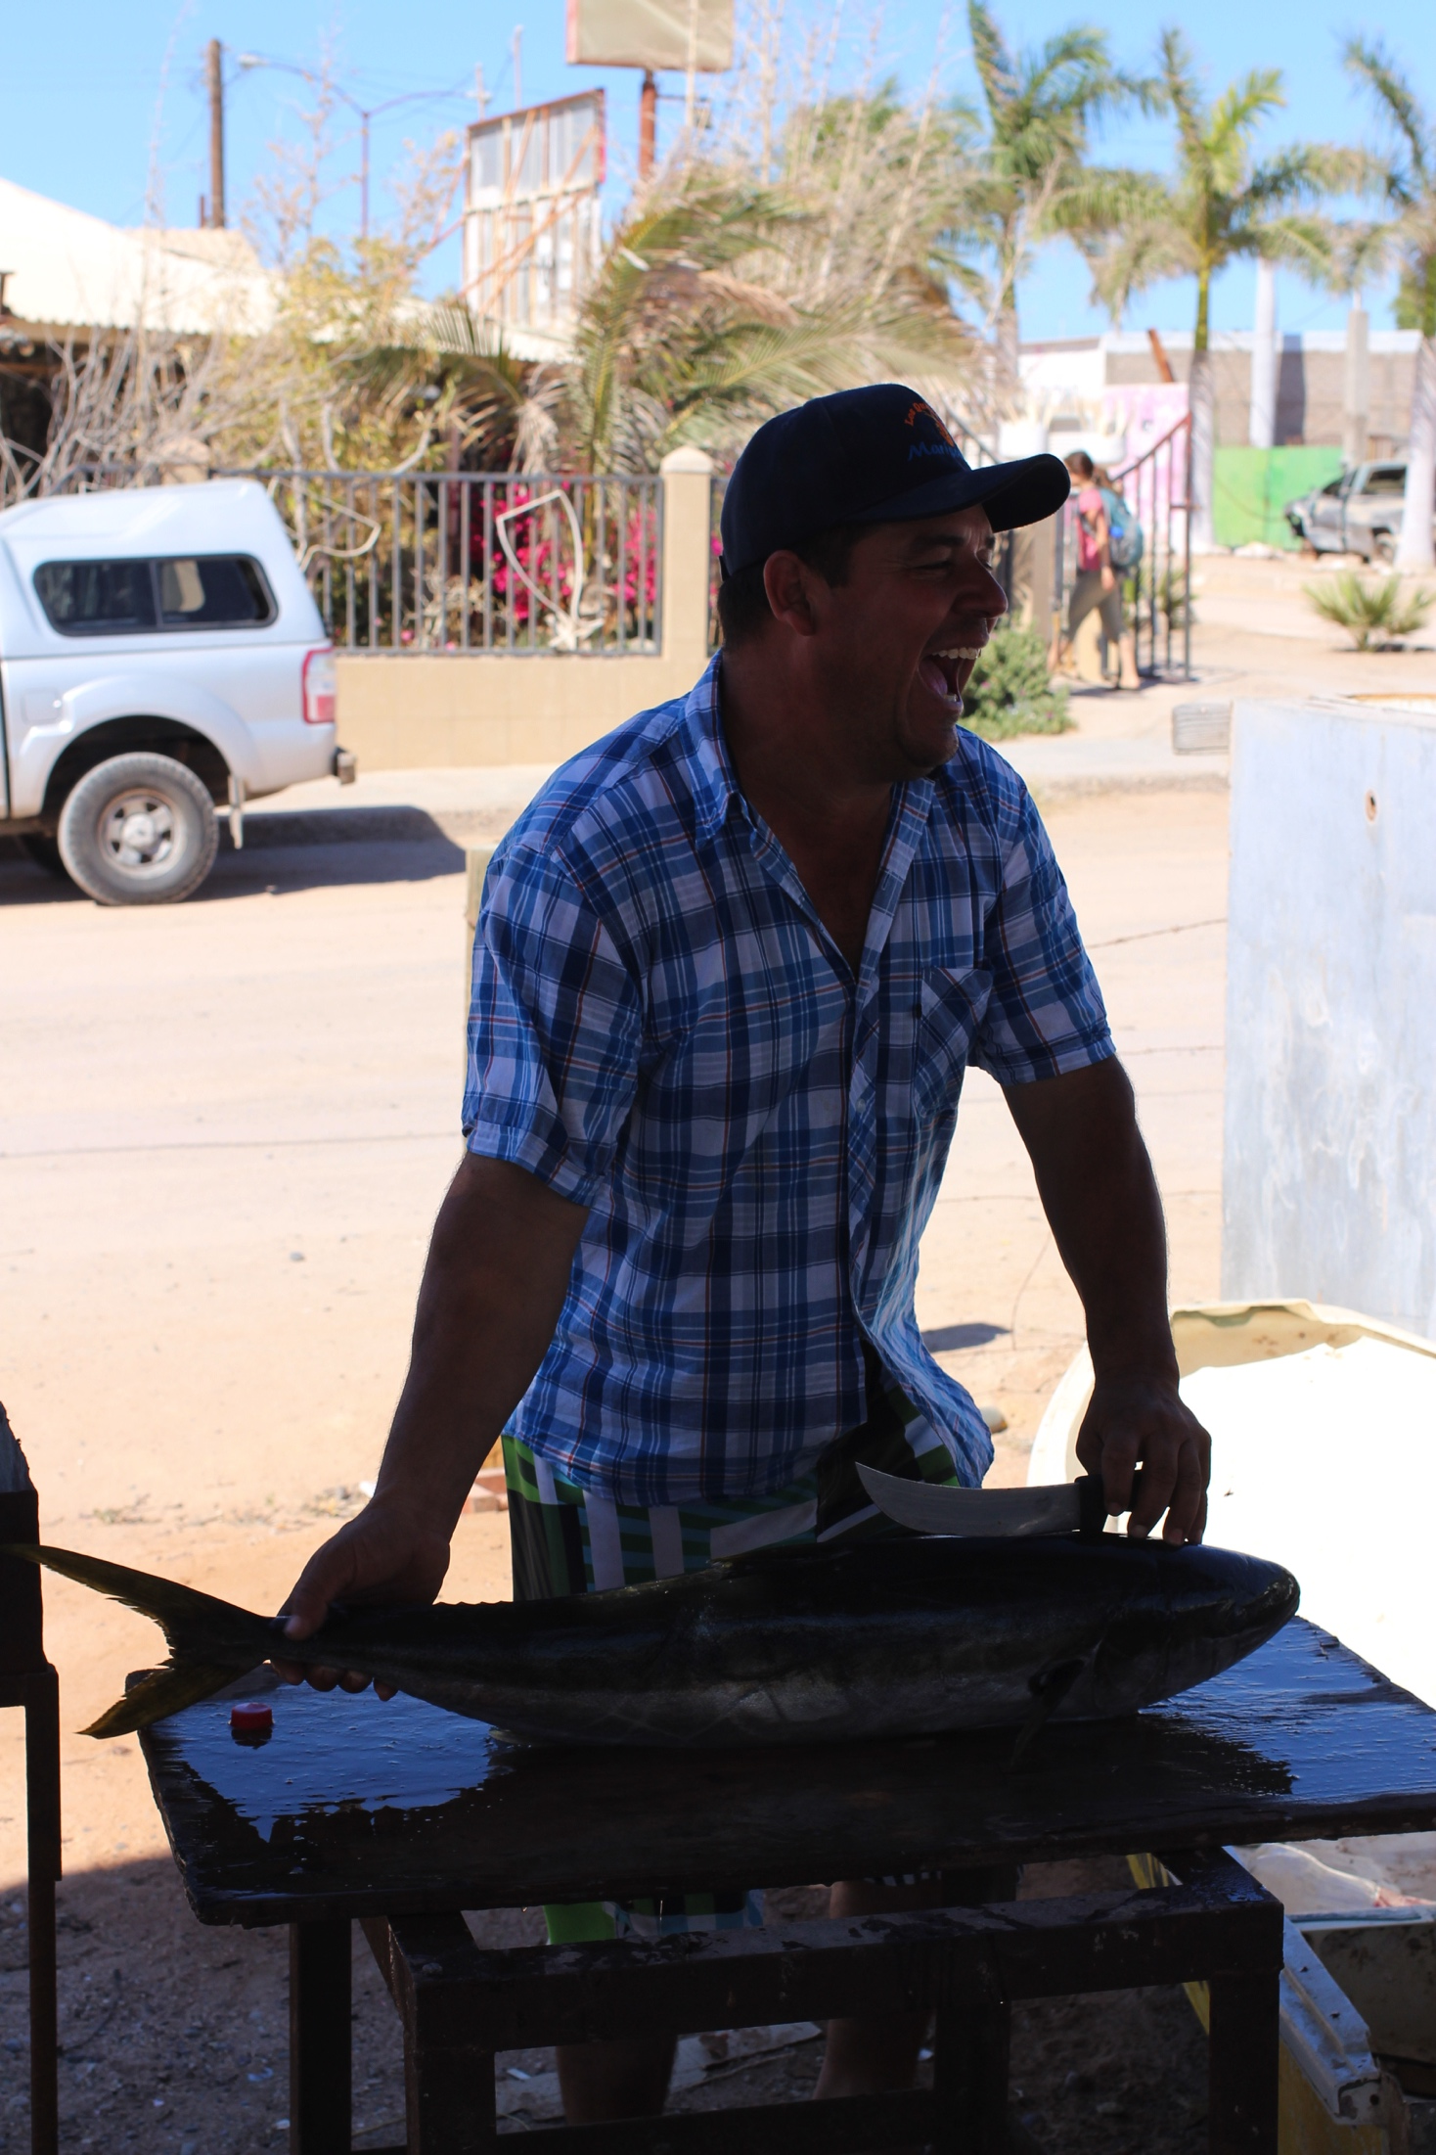
Whose knowledge counts?

Slide 16
Traditional Ecological Knowledge
(TEK, LEK)
Theoretical
foundation
Research
question
Findings and
discussion
Methods
Notes:
Interest in LEK; how to find experts? Use peer system (Identifying “experts”) -- technocratic
“Who Knows? On the Importance of Identifying “Experts” When Researching Local Ecological Knowledge” (Davis and Wagner 2003) – how to find LEK experts
Per Olsson and Carl Folke (2001) (highly cited) – finds that local knowledge/mgmt mimics ecosystem approach; local knowledge builds ecological resilience, adaptive approach
Grant Gilchrist, Mark Mallory, and Flemming Merkel (2005)
In some circumstances, local ecological knowledge (LEK) can serve as a useful, complementary data source, and may be particularly valuable when managing wildlife populations that occur in remote locations inhabited by indigenous peoples.

Slide 17
Traditional Ecological Knowledge
(TEK, LEK)
Incomplete knowledge
Variability and unpredictability
Knowing differently
Theoretical
foundation
Research
question
Findings and
discussion
Methods
Notes:
Interest in LEK; how to find experts? Use peer system (Identifying “experts”) -- technocratic
“Who Knows? On the Importance of Identifying “Experts” When Researching Local Ecological Knowledge” (Davis and Wagner 2003) – how to find LEK experts
Per Olsson and Carl Folke (2001) (highly cited) – finds that local knowledge/mgmt mimics ecosystem approach; local knowledge builds ecological resilience, adaptive approach
Grant Gilchrist, Mark Mallory, and Flemming Merkel (2005)
In some circumstances, local ecological knowledge (LEK) can serve as a useful, complementary data source, and may be particularly valuable when managing wildlife populations that occur in remote locations inhabited by indigenous peoples.

Slide 18
Traditional Ecological Knowledge
(TEK, LEK)
Incomplete knowledge
Variability and unpredictability
Knowing differently
Theoretical
foundation
Research
question
Findings and
discussion
Methods
Notes:
Interest in LEK; how to find experts? Use peer system (Identifying “experts”) -- technocratic
“Who Knows? On the Importance of Identifying “Experts” When Researching Local Ecological Knowledge” (Davis and Wagner 2003) – how to find LEK experts
Per Olsson and Carl Folke (2001) (highly cited) – finds that local knowledge/mgmt mimics ecosystem approach; local knowledge builds ecological resilience, adaptive approach
Grant Gilchrist, Mark Mallory, and Flemming Merkel (2005)
In some circumstances, local ecological knowledge (LEK) can serve as a useful, complementary data source, and may be particularly valuable when managing wildlife populations that occur in remote locations inhabited by indigenous peoples.

Slide 19
Traditional Ecological Knowledge
(TEK, LEK)
Davis and Wagner (2003)
Grant Gilchrist, Mark Mallory, and Flemming Merkel (2005)
Per Olsson and Carl Folke (2001)
How to find LEK experts
LEK a “useful, complementary data source when managing wildlife populations in remote locations inhabited by indigenous peoples”
Local knowledge builds ecological resilience, adaptive approach
Theoretical
foundation
Research
question
Findings and
discussion
Methods
Notes:
Interest in LEK; how to find experts? Use peer system (Identifying “experts”) -- technocratic
“Who Knows? On the Importance of Identifying “Experts” When Researching Local Ecological Knowledge” (Davis and Wagner 2003) – how to find LEK experts
Per Olsson and Carl Folke (2001) (highly cited) – finds that local knowledge/mgmt mimics ecosystem approach; local knowledge builds ecological resilience, adaptive approach
Grant Gilchrist, Mark Mallory, and Flemming Merkel (2005)
In some circumstances, local ecological knowledge (LEK) can serve as a useful, complementary data source, and may be particularly valuable when managing wildlife populations that occur in remote locations inhabited by indigenous peoples.

Slide 20
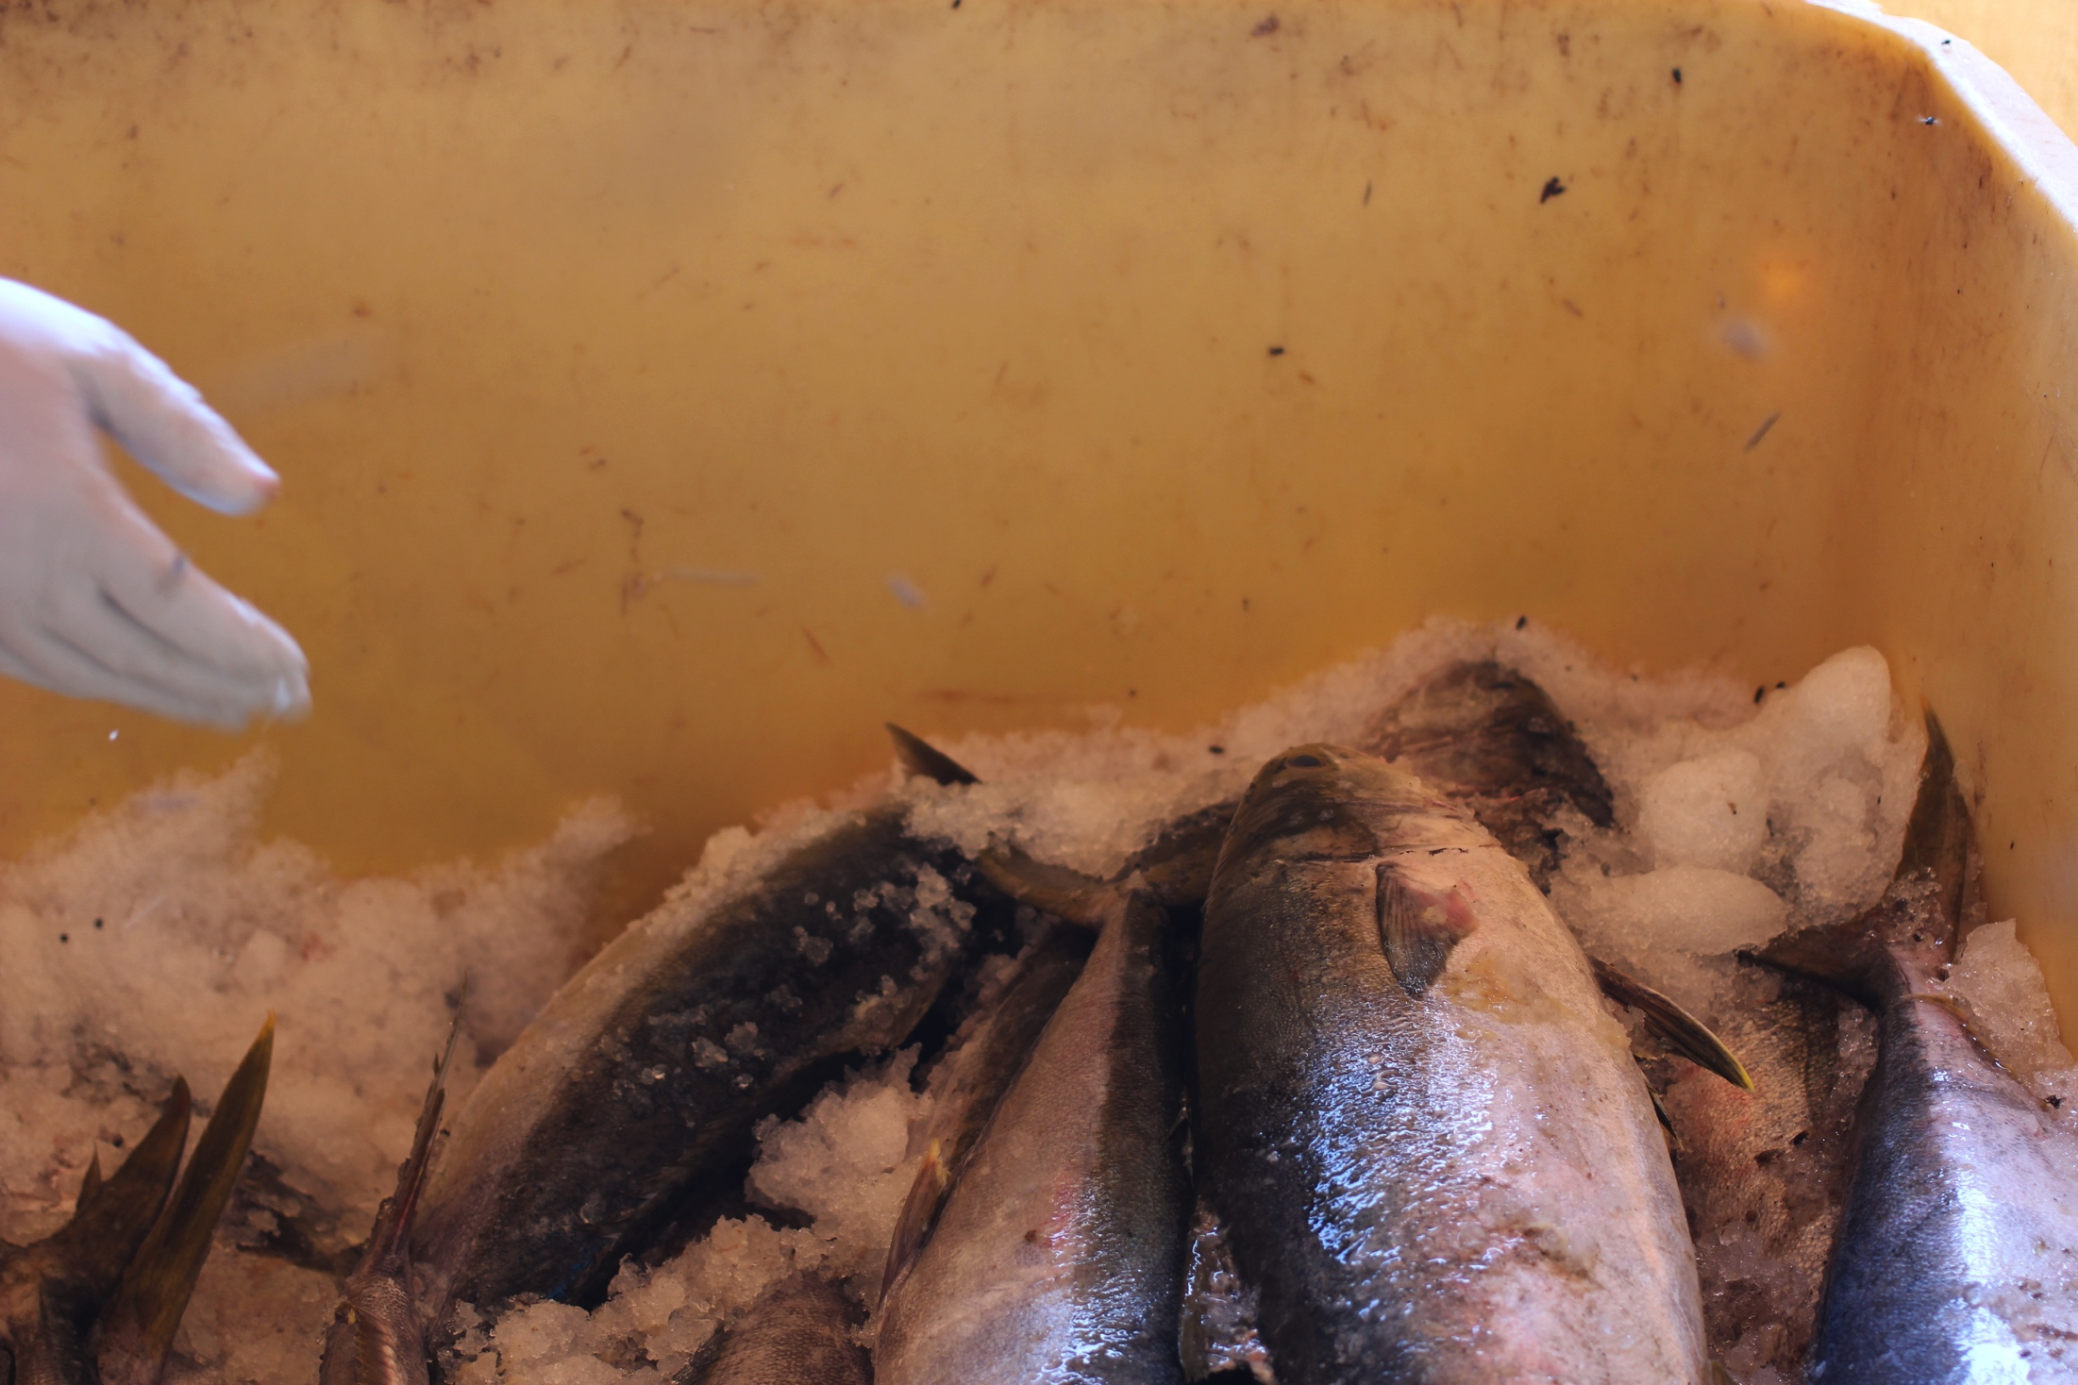
Is the problem information, or politics?
(Judith Floor)

Slide 21
How does resource users’ participation in
an ecological monitoring program influence the legitimacy of that information?
Theoretical
foundation
Research
question
Findings and
discussion
Methods

Slide 22
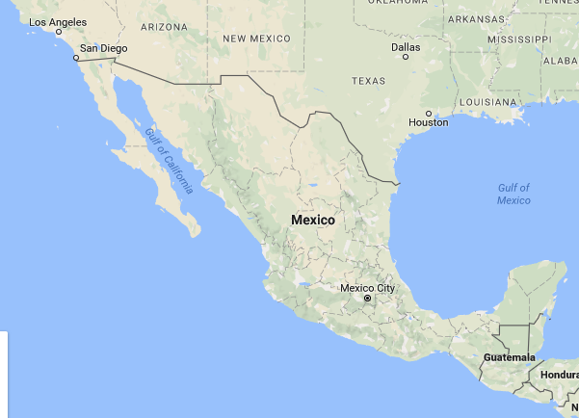

Slide 23
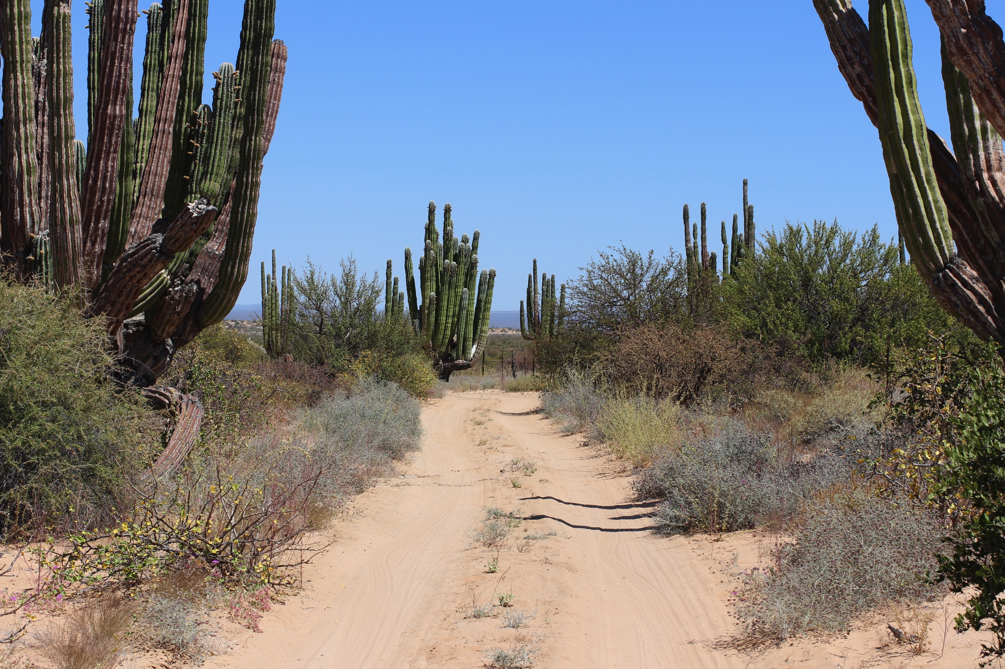

Slide 24
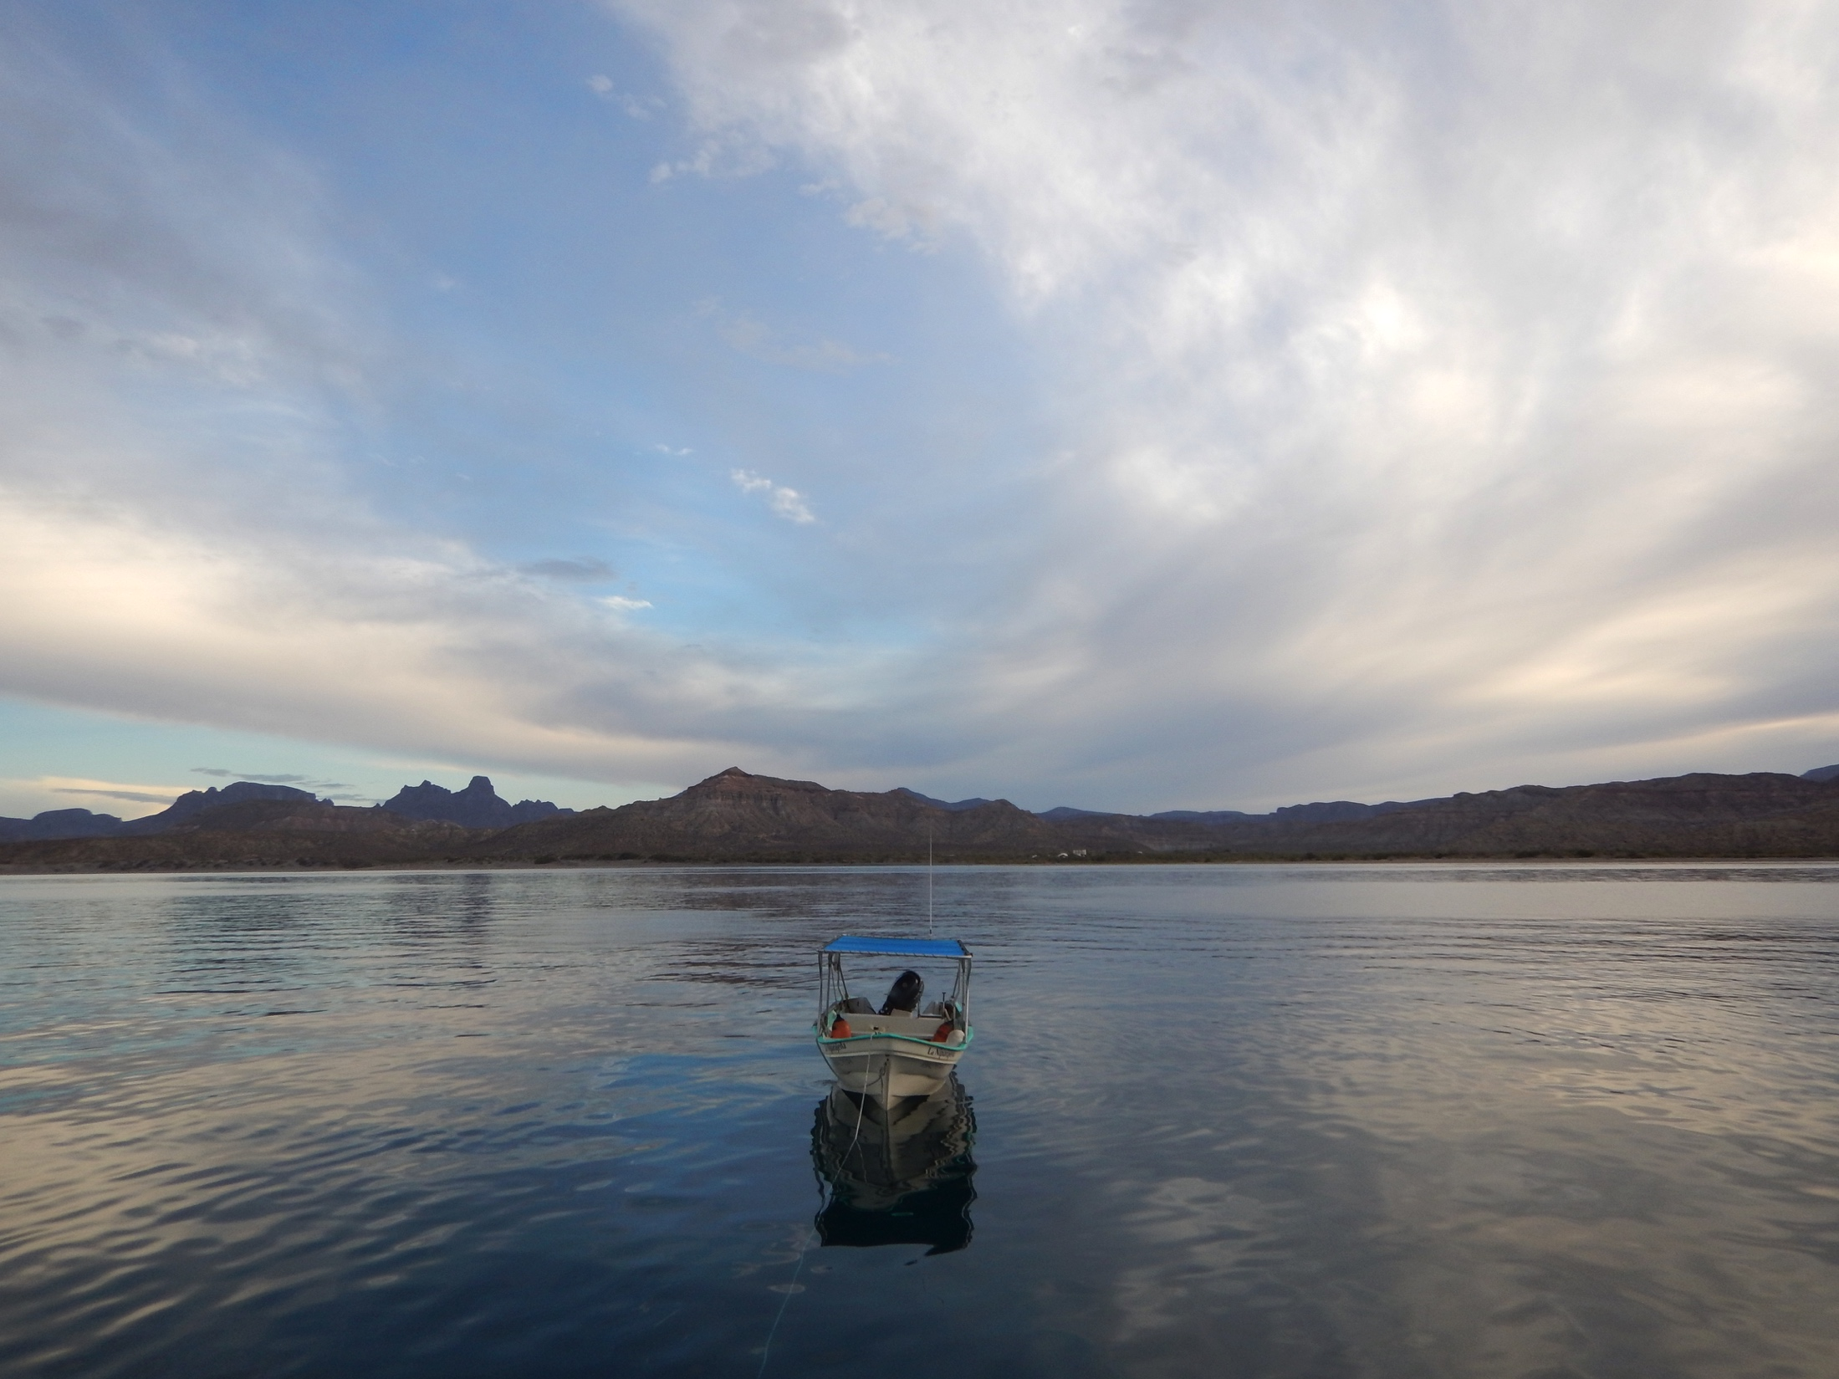

Slide 25
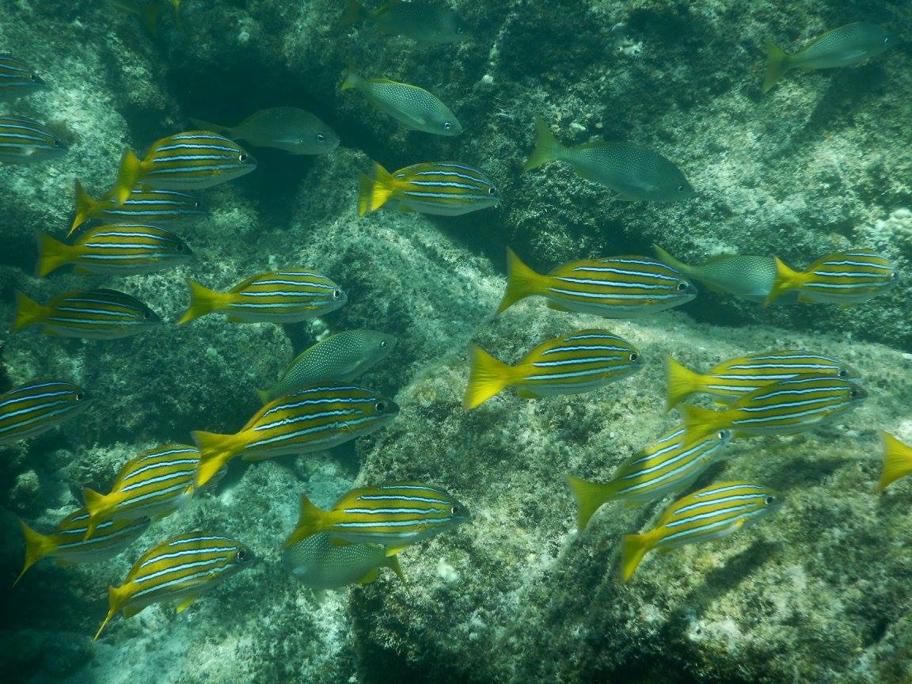

Slide 26
Ethnographic Methods
3 months in field, research cruise with one group
Semi-structured interviews (51)
  16 Buzos Monitores
  32 family and community members
  2 government officials, 1 with NGO partner
Theoretical
foundation
Research
question
Findings and
discussion
Methods
Notes:
The key to ethnography is extended time in the field
Agua Verde, Tembabiche, San Evaristo, Kino Bay, research cruise
- Importantly, time with divers both on their research cruise and in their home towns, fishing

Slide 27
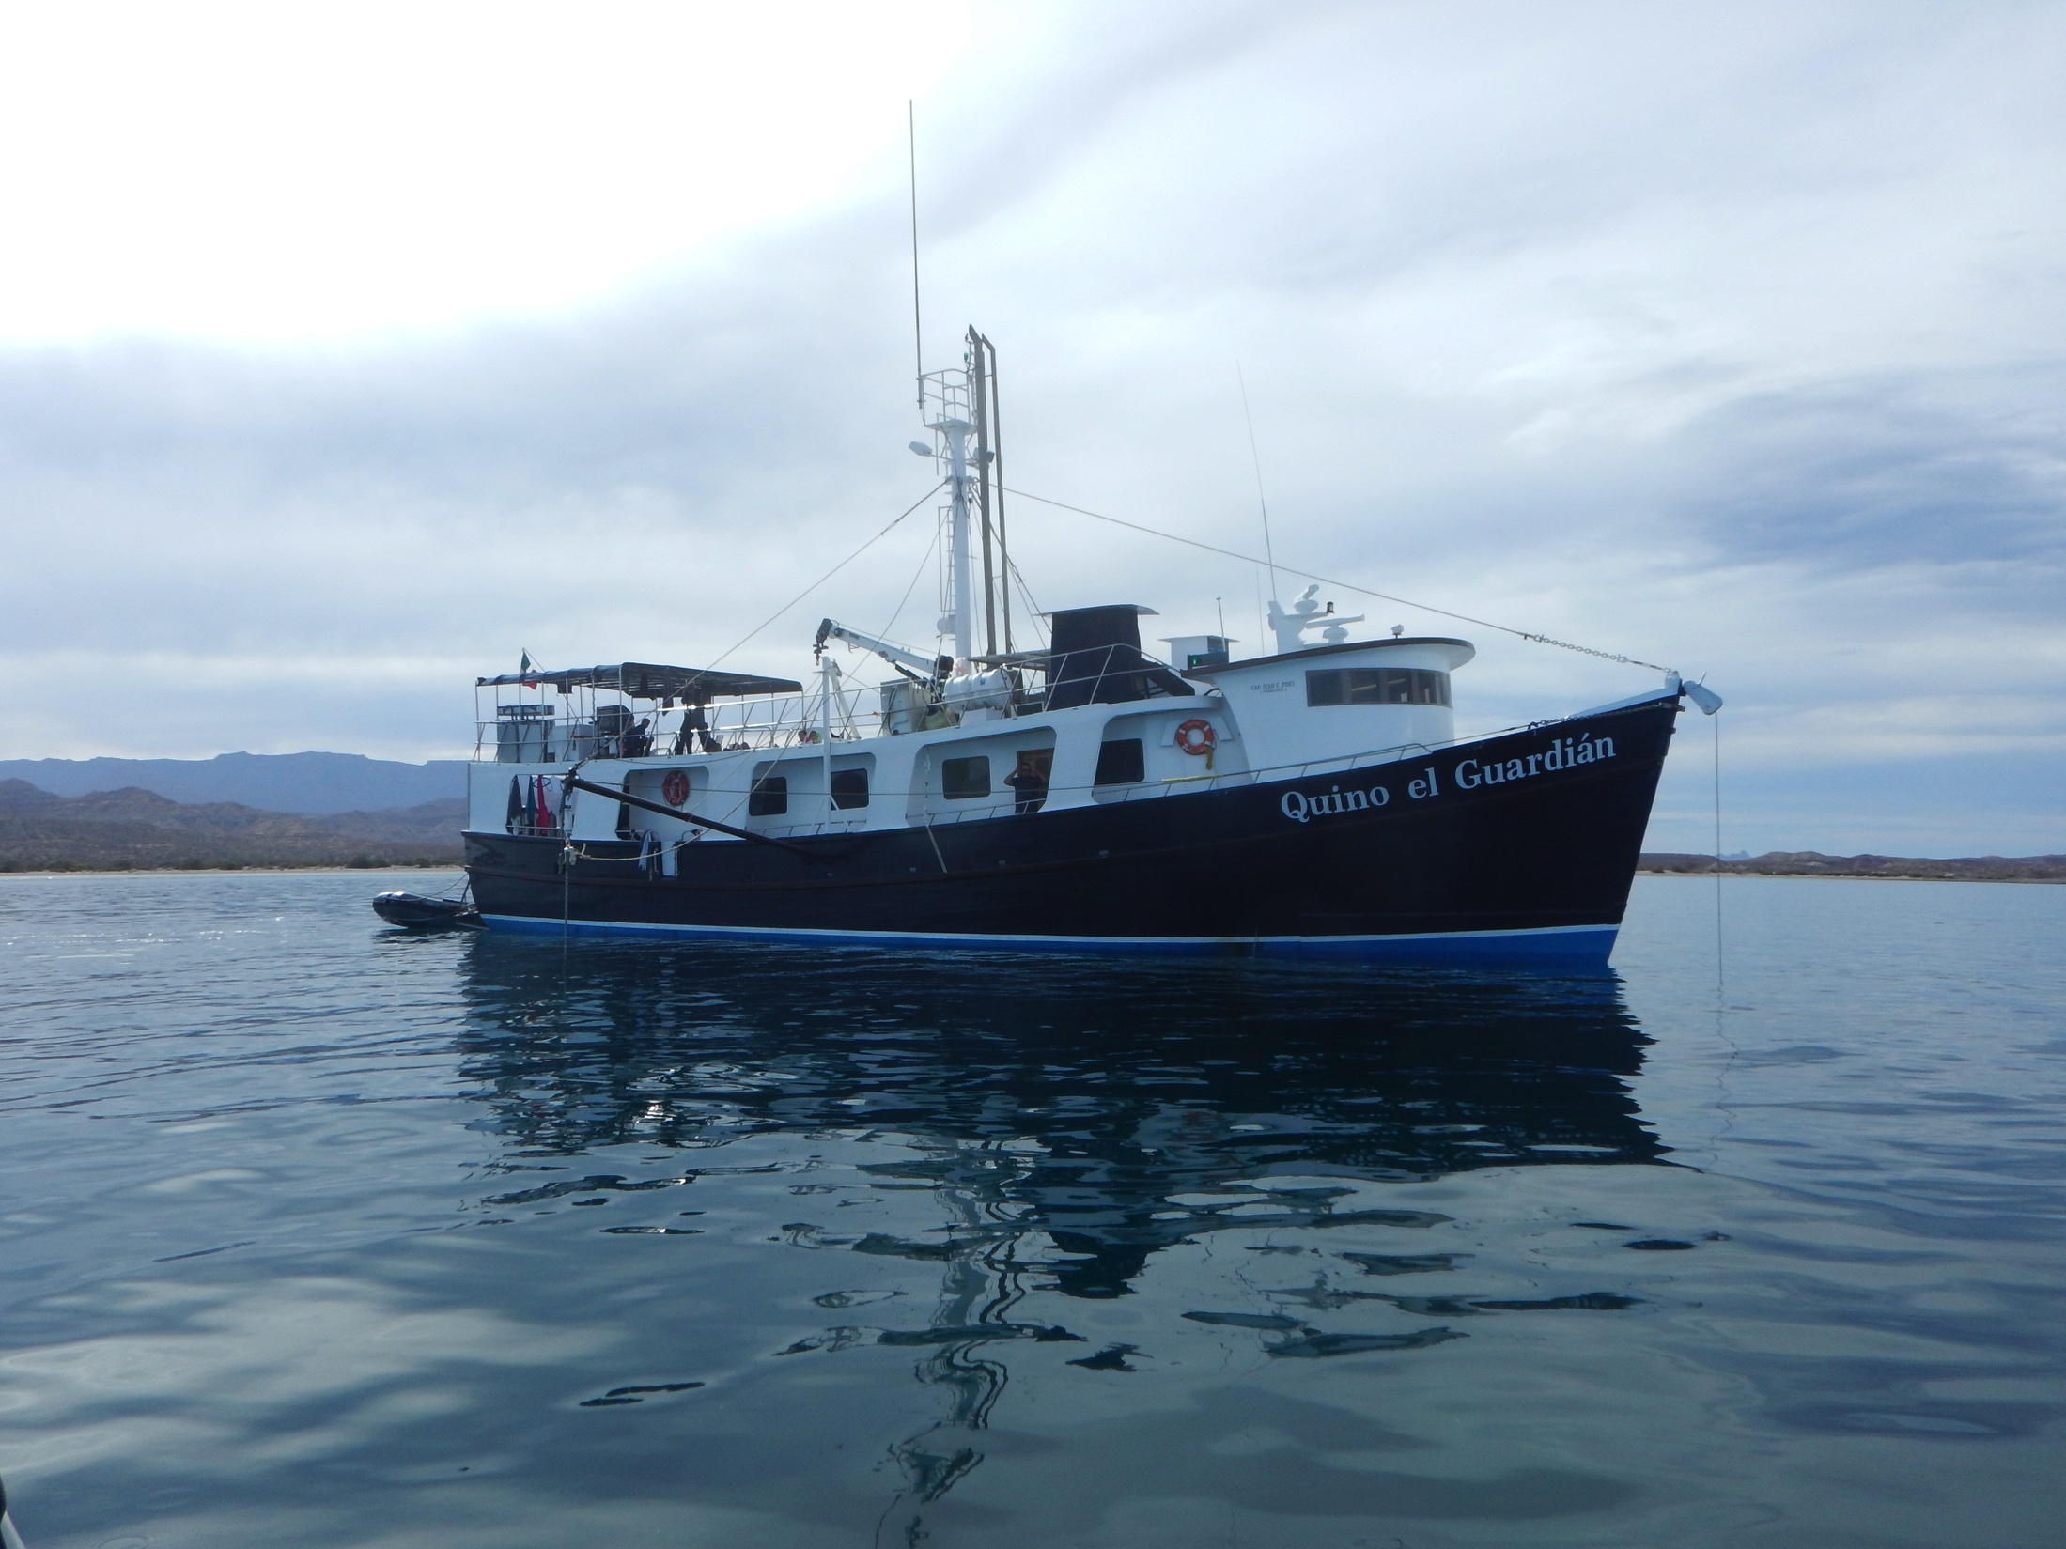

Slide 28
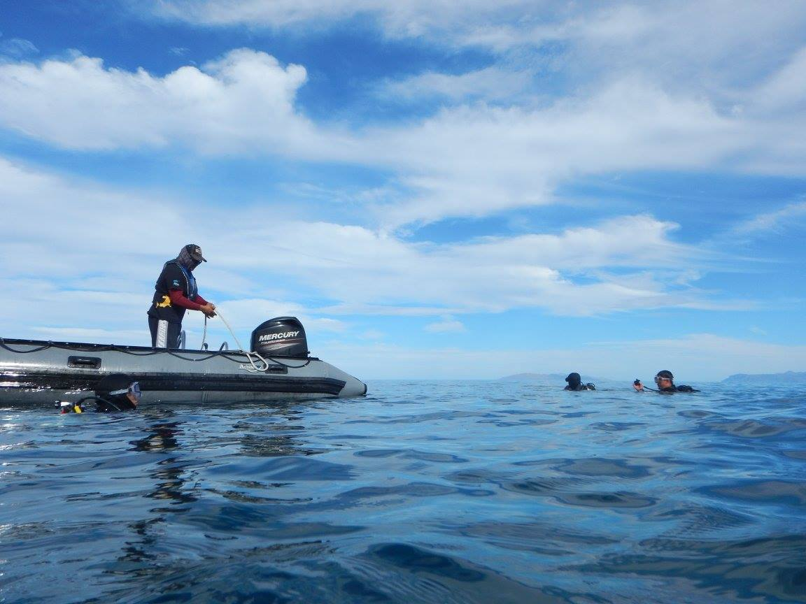

Slide 29
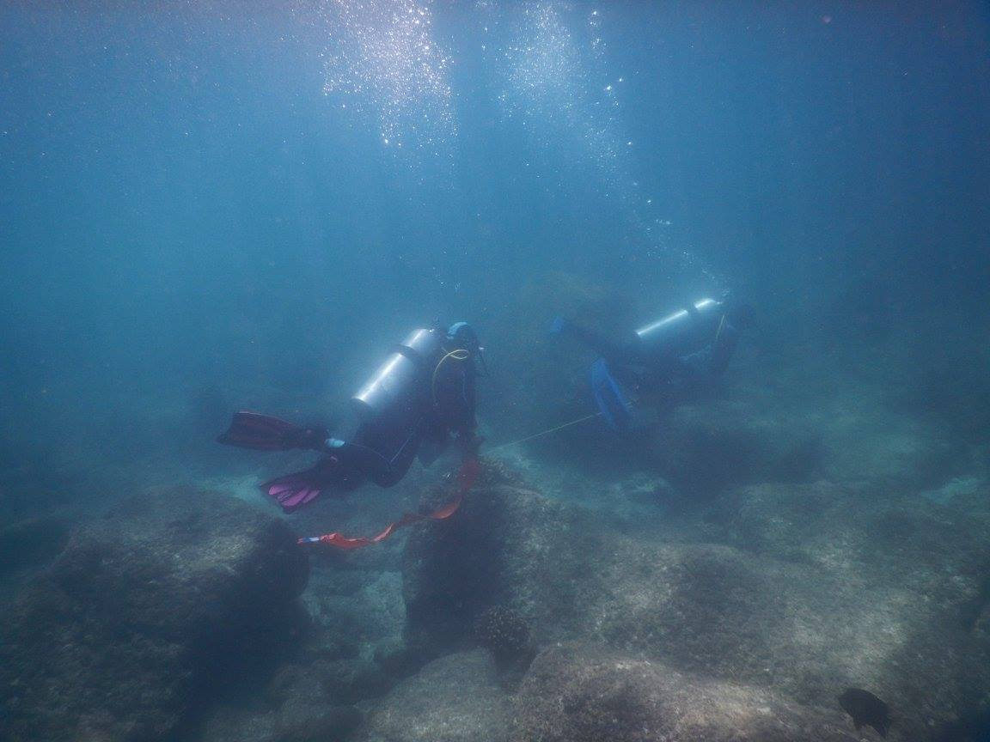

Slide 30
Interview-based method
Semi-structured interviews (51)
  16 Buzos Monitores
  32 family and community members
  2 government officials, 1 with NGO partner
Theoretical
foundation
Research
question
Findings and
discussion
Methods
Notes:
The key to ethnography is extended time in the field
Agua Verde, Tembabiche, San Evaristo, Kino Bay, research cruise
- Importantly, time with divers both on their research cruise and in their home towns, fishing

Slide 31
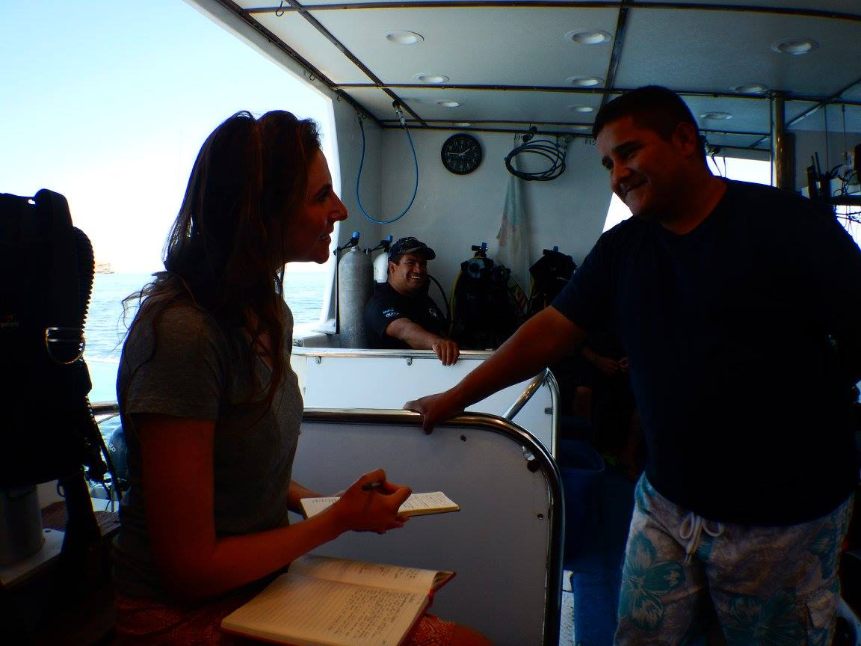

Slide 32
Interviews
Theme | Topic
Historical | Formation of the group Participation in the group
Economic/livelihood | Direct financial effect Risk and stability Decent work, type of work
Social | Behavioral changes, trust, credibility Social changes
Gender | Women and Buzos Monitores, effects on livelihoods
Values | What it means to be a Buzo Montor Who benefits from the information, who should pay for the program Value of the information
Information | Legitimacy of information
Governance | Empowerment, management of fisheries Monitoring and enforcement of illegal fishing
Theoretical
foundation
Research
question
Findings and
discussion
Methods
Notes:
Historical
Formation of the group
Participation in the group
Economical
Direct financial effect: income or loss?
Risk and stability of work
Financial effect on family?
Social
Governance
Values

Slide 33
Interviews
Theme | Topic
Historical | Formation of the group Participation in the group
Economic/livelihood | Direct financial effect Risk and stability Decent work, type of work
Social | Behavioral changes, trust, credibility Social changes
Gender | Women and Buzos Monitores, effects on livelihoods
Values | What it means to be a Buzo Montor Who benefits from the information, who should pay for the program Value of the information
Information | Legitimacy of information
Governance | Empowerment, management of fisheries Monitoring and enforcement of illegal fishing
Theoretical
foundation
Research
question
Findings and
discussion
Methods
Notes:
Historical
Formation of the group
Participation in the group
Economical
Direct financial effect: income or loss?
Risk and stability of work
Financial effect on family?
Social
Governance
Values

Slide 34
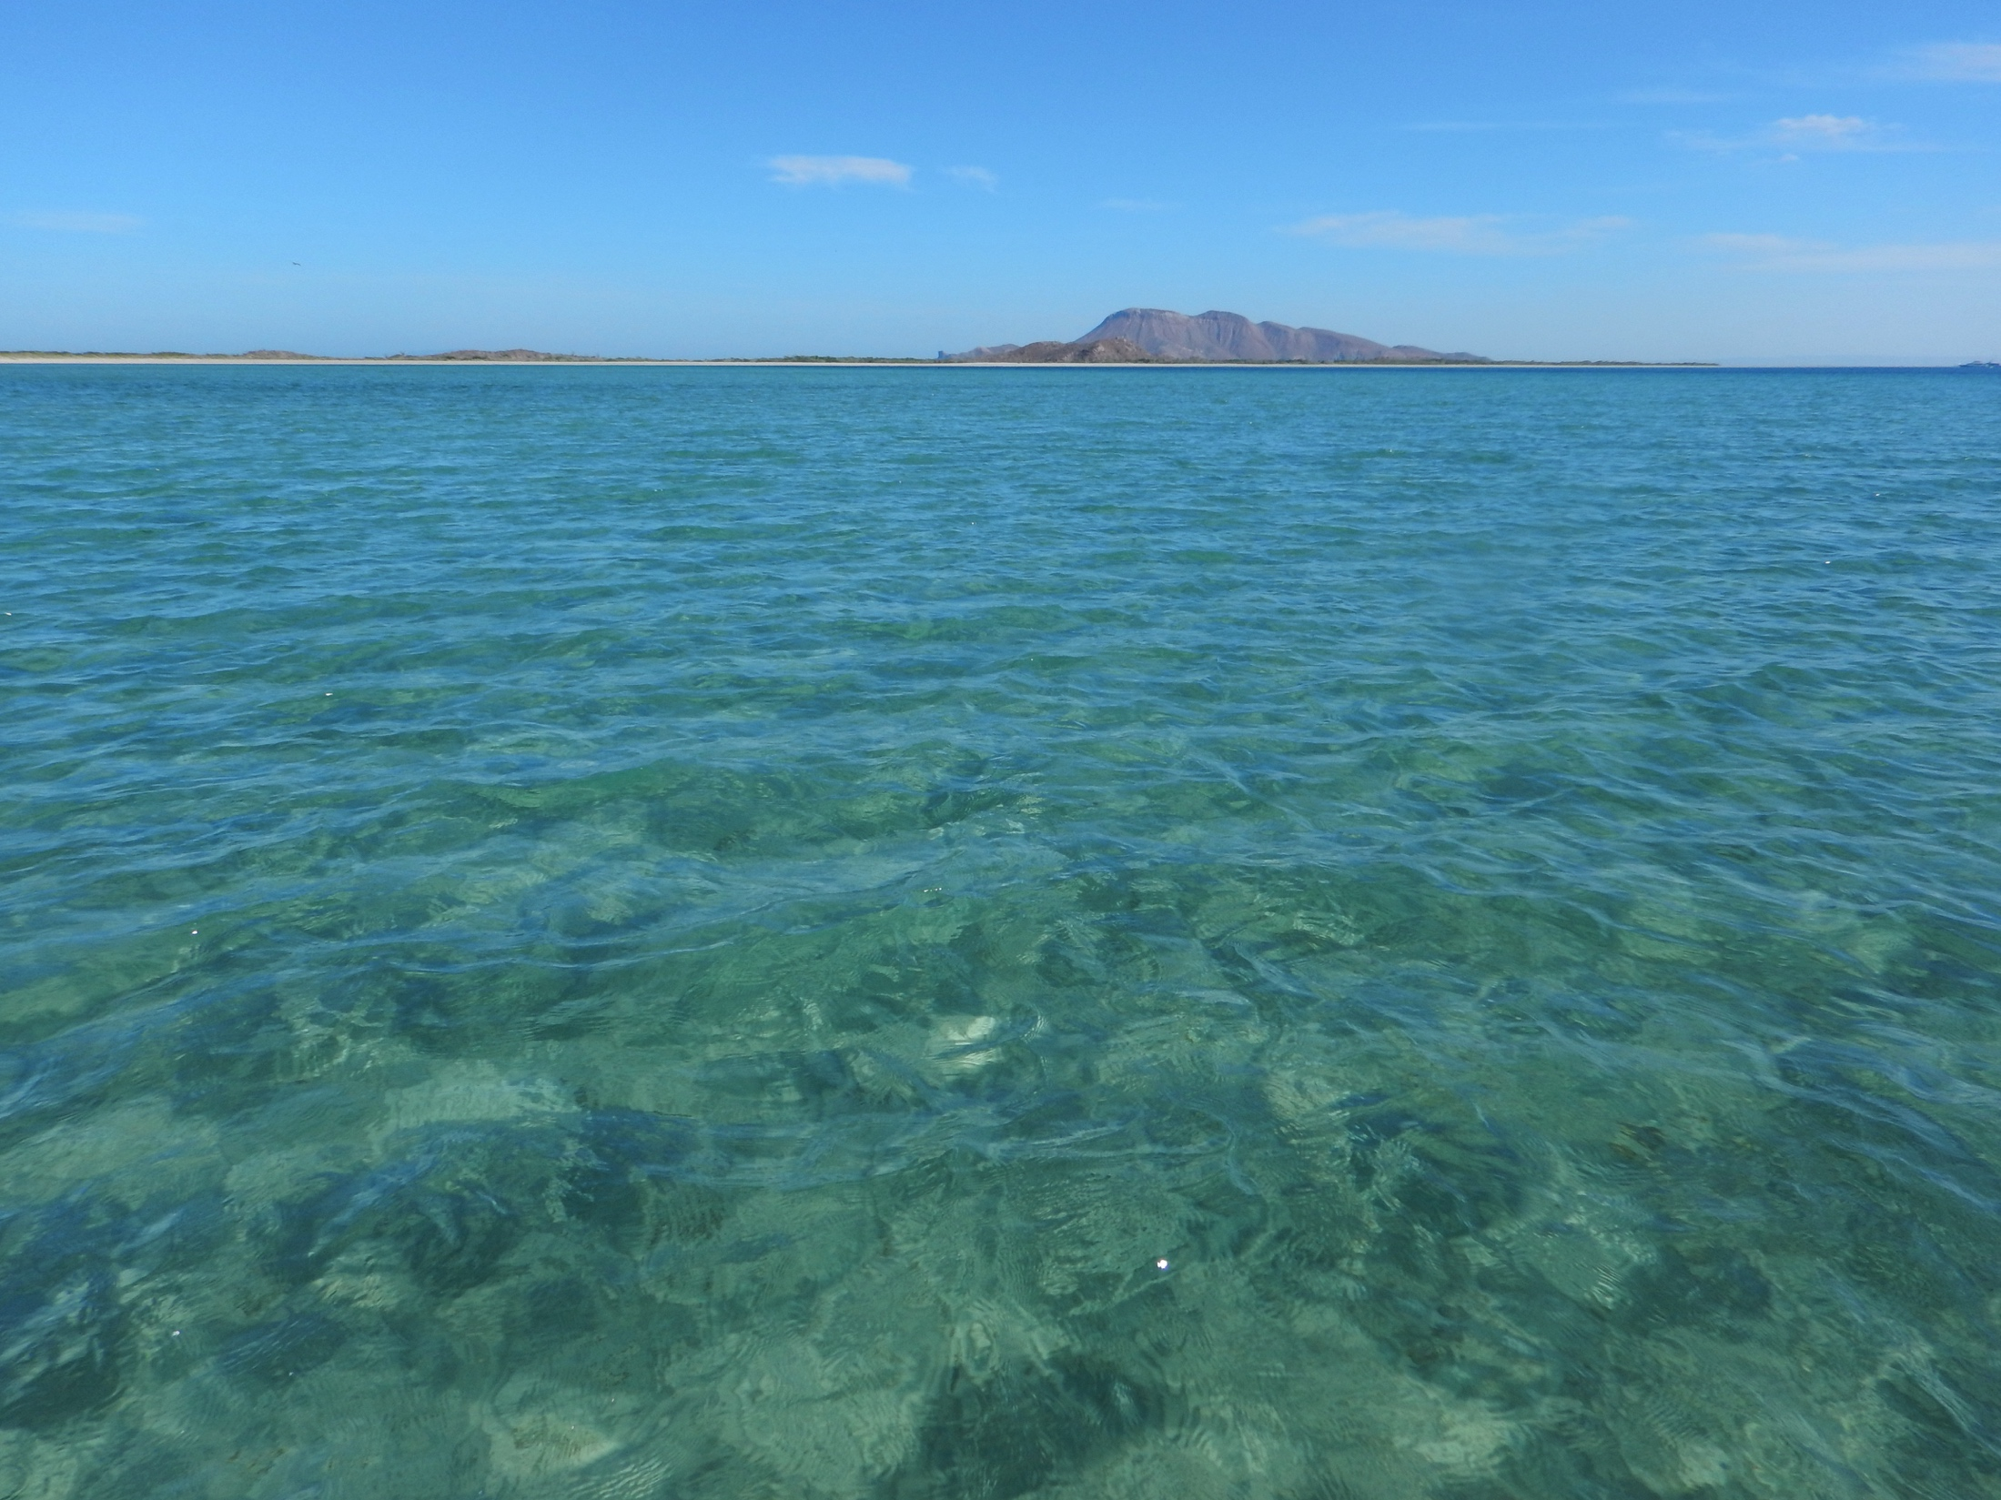
Findings and discussion
Theoretical
foundation
Research
question
Findings and
discussion
Methods

Slide 35
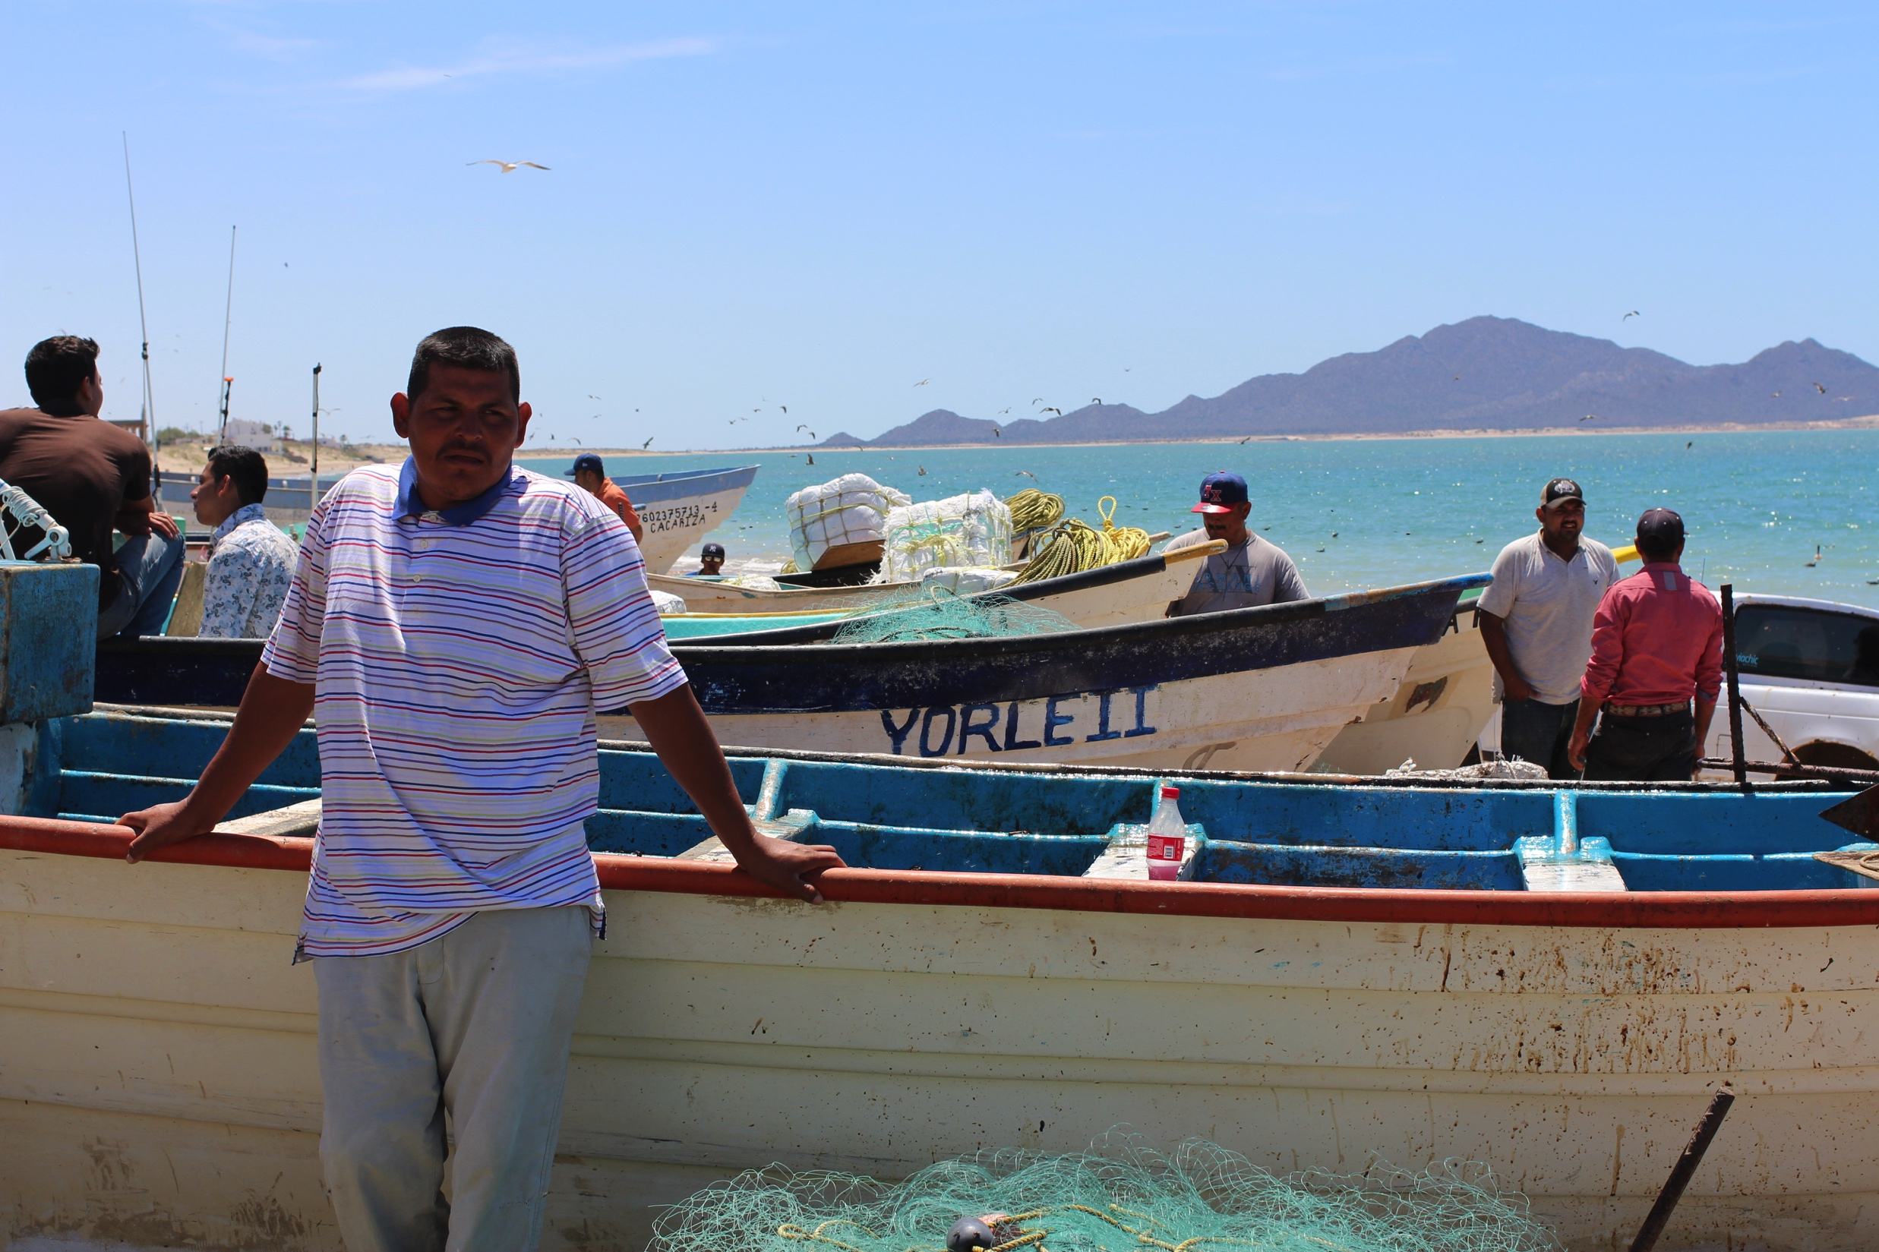

Slide 36
Legitimacy and LEK
Legitimacy OF WHAT?
Legitimacy TO WHOM?
Theoretical
foundation
Research
question
Findings and
discussion
Methods

Slide 37
Legitimacy and LEK
Fishing community trusts Buzo Monitor data
“So a marine biologist knows a lot about the ocean. But a fisher knows the ocean, knows a lot. The biologist knows the theory, scientifically, but in the question of reality, it's the fisher.”
“As fishers, they always have knowledge about many things about the sea.”
Theoretical
foundation
Research
question
Findings and
discussion
Methods
Notes:
29/30 interviewed said they trusted

Slide 38
Legitimacy and LEK
Intersection of legitimacy and fishing organization
Theoretical
foundation
Research
question
Findings and
discussion
Methods

Slide 39


3 towns, 3 organizations
1.
3.
2.
Theoretical
foundation
Research
question
Findings and
discussion
Methods

Slide 40
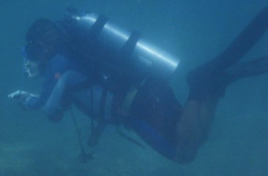
3 towns, 3 organizations
1. all coops w/BM
3. one coop w/ no BM
X
2. no cooperatives
one coop w/BM
Theoretical
foundation
Research
question
Findings and
discussion
Methods

Slide 41
Legitimacy and governance impacts
Towns with cooperatives: polarize opinion around Fishing Refugia
  Cooperatives with a Buzo Monitor: greater belief in effectiveness and value of Refugia
  Cooperatives without a Buzo Monitor: strong resistance to Refugia
X
Theoretical
foundation
Research
question
Findings and
discussion
Methods

Slide 42

Legitimacy and governance impacts
Towns without cooperatives: more apathy towards Fishing Refugia and Buzo Monitor project
  Don’t know what they do
  “Presentations to the community are
  infrequent and he has never told me
  the purpose of the program”
Theoretical
foundation
Research
question
Findings and
discussion
Methods

Slide 43
Trust and participation
Trust of information is based on personal relationships
  “They're a couple of guys who people really like, Chapa and Felix are appreciated here. People see them well, people like them. They don’t drink, they don't do drugs, they're good kids. People think they're doing a good work because they like them.”
  “I basically don’t trust the information that the Buzos Monitores produce; there are lots of corrupt Buzos Monitores who fish in the Refugia and they don’t present their work.”
Theoretical
foundation
Research
question
Findings and
discussion
Methods

Slide 44
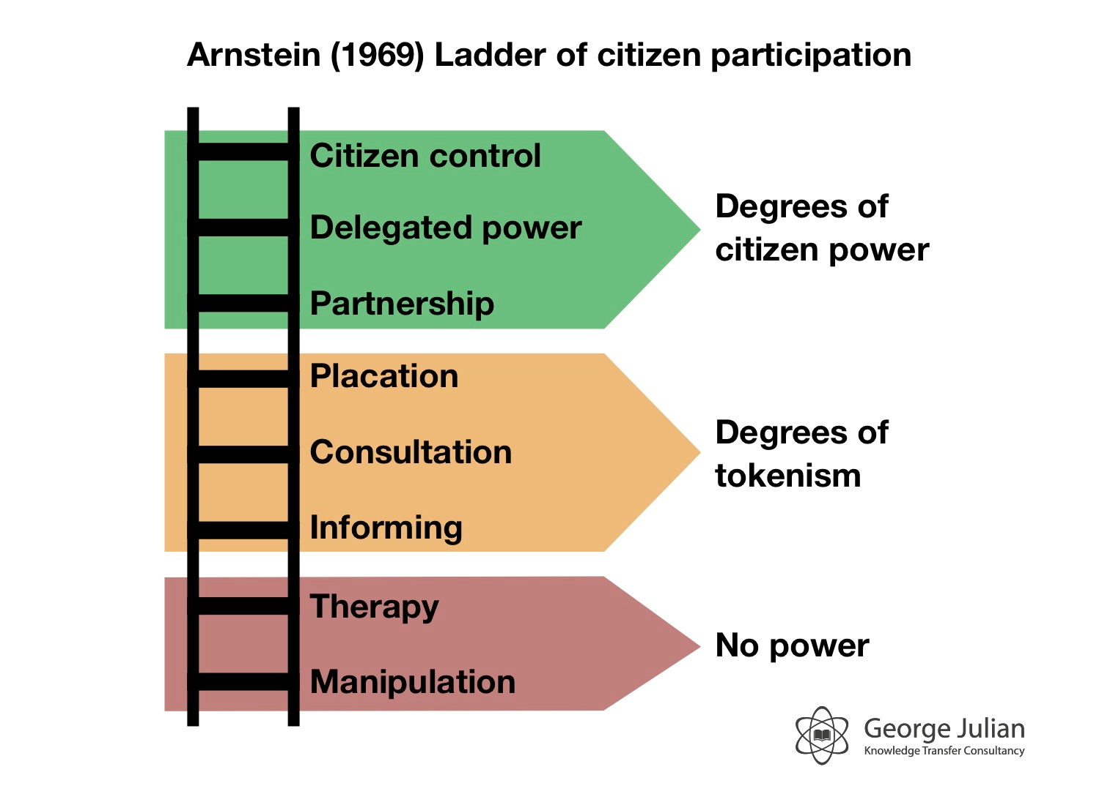
Arnstein 1969

Slide 45
Conclusions
Theoretical
foundation
Research
question
Findings and
discussion
Methods

Slide 46
Legitimacy of ecological information intersects with organization
Participation in knowledge production increases perceived legitimacy
But, this is mediated by perceptions of individuals
Cooperatives may facilitate shared ownership of information
Theoretical
foundation
Research
question
Findings and
discussion
Methods

Slide 47
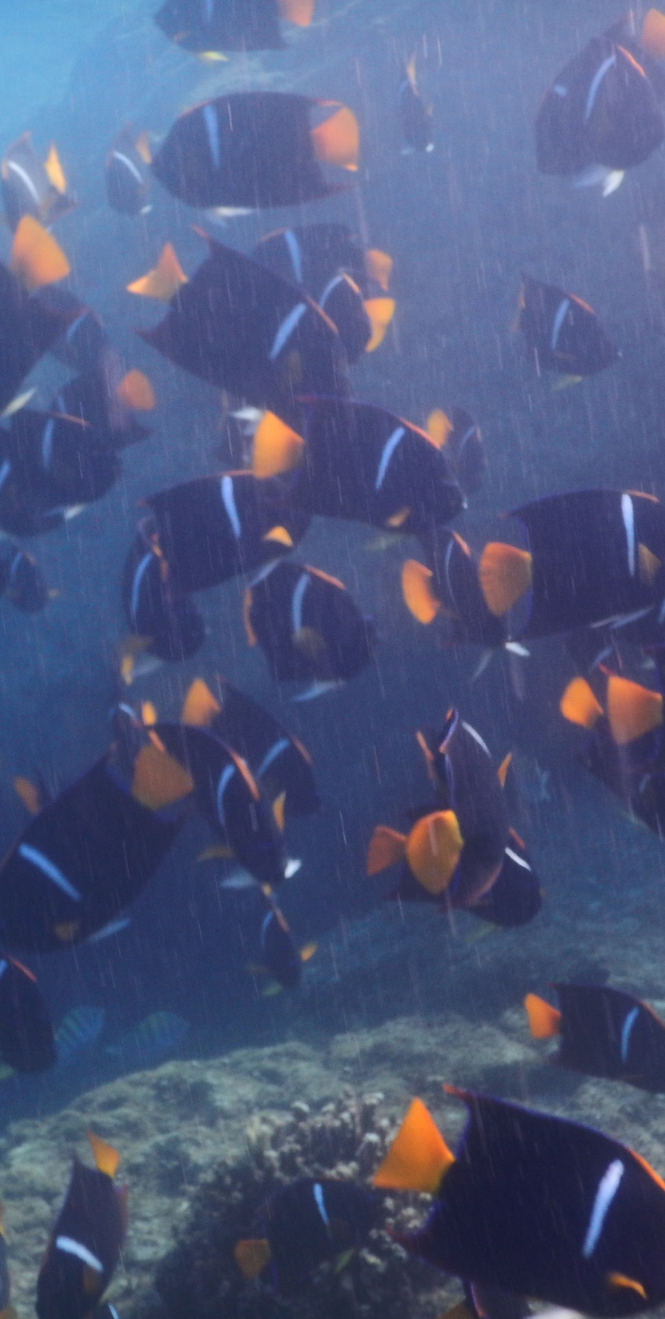



Acknowledgements
Collaborators and mentors:
Xavier Basurto, Lisa Cambell, Grant Murray, Mateja Nenadovich, Amy Hudson Weaver, Salvador Rodriguez Van Dyck
Organizations: National Science Foundation, Niparaja
Informants: Buzos Monitores and their families, fishers of Agua Verde, San Evaristo, Tembabiche, and Kino Bay, Dona Eva Morales

Slide 48

Anastasia Quintana acq@duke.edu

Slide 49
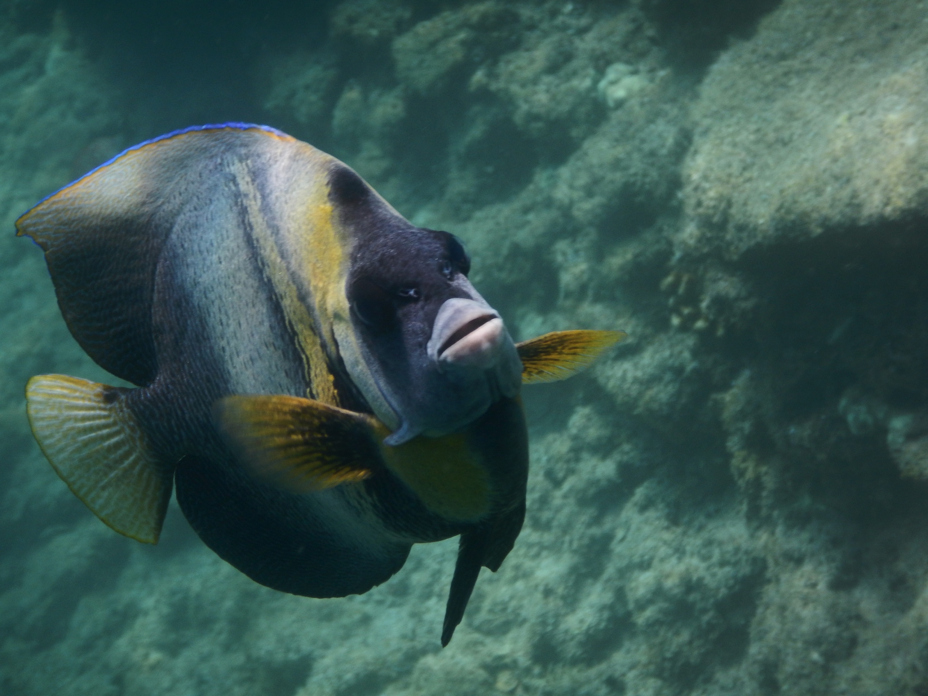
Questions?

Slide 50
Arnstein 1969

Slide 51
governmentality

Slide 52
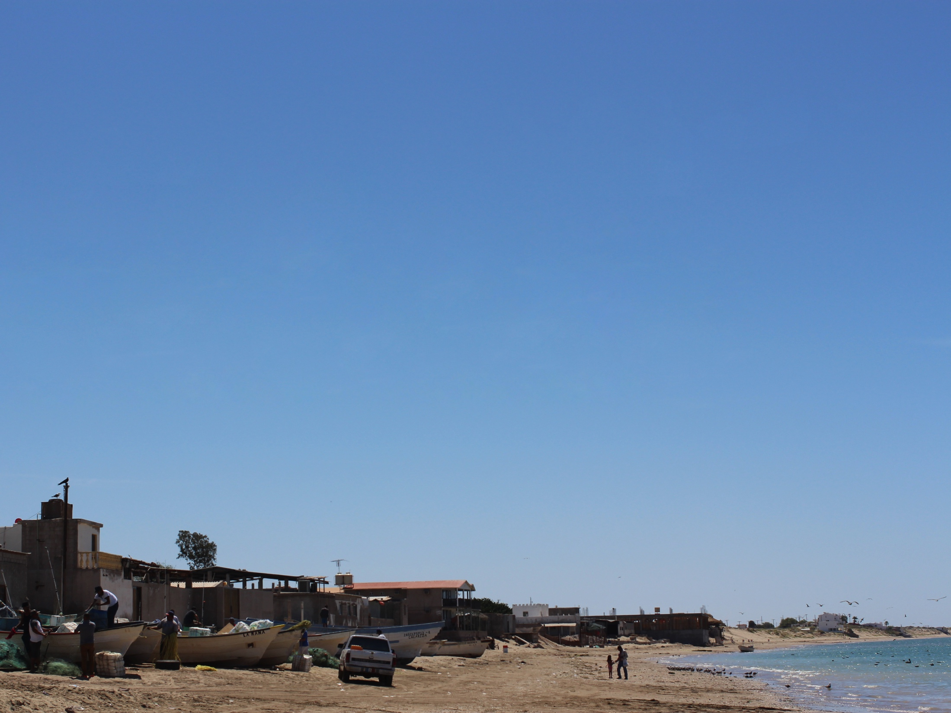
Governmentality and the
“project of government”
Foucault on “governmentality”
  “the techniques and strategies by which a society is rendered governable”
  “the art of government”
  “the conduct of conduct”
Governmentality is neoliberal
Tania Li: the “project” of government
Notes:
Foucault: “the techniques and strategies by which a society is rendered governable”
“the art of government”
“the conduct of conduct”
Neoliberal governmentality: when the government devolves power by creating self-governing citizens – cynical view of self-governaning citizenry and governability
Tania Li: the “project” of government, governing others → the governing system defining itself, the problems, and the solutions under a neoliberal, capitalist world order

Slide 53
Foucault’s definition of governmentality:
"1. The ensemble formed by the institutions, procedures, analyses and reflections, the calculations and tactics that allow the exercise of this very specific albeit complex form of power, which has as its target population, as its principal form of knowledge political economy, and as its essential technical means apparatuses of security.
2. The tendency which, over a long period and throughout the West, has steadily led towards the pre-eminence over all other forms (sovereignty, discipline, etc) of this type of power which may be termed government, resulting, on the one hand, in formation of a whole series of specific governmental apparatuses, and, on the other, in the development of a whole complex of savoirs.
3. The process, or rather the result of the process, through which the state of justice of the Middle Ages, transformed into the administrative state during the fifteenth and sixteenth centuries, gradually becomes 'governmentalized'."
Notes:
Foucault: “the techniques and strategies by which a society is rendered governable”
“the art of government”
“the conduct of conduct”
Neoliberal governmentality: when the government devolves power by creating self-governing citizens – cynical view of self-governaning citizenry and governability
Tania Li: the “project” of government, governing others → the governing system defining itself, the problems, and the solutions under a neoliberal, capitalist world order

Slide 54
Buzos Monitores are environmental subjects
“He values fishing more. I've seen it in him. For example, if he takes out fish, like a cochi, which is what we call taxis, he would throw it back. But before, we would just kill it. But now, that's not the case, he throws it back alive. It's very interesting”
Theoretical
foundation
Research
question
Findings and
discussion
Methods

Slide 55
Buzos Monitores are NOT environmental subjects
“For me, what has changed is the form of thinking. That you can do other things, work in other jobs, other parts. That because of the courses, we have more skills.”
Theoretical
foundation
Research
question
Findings and
discussion
Methods

Slide 56
Opinions of Buzo Monitor program
“They know more, they’re different now”
“We are more responsible and express ourselves better”
“We are more organized”
“Nothing, it’s just a job”
“They know how to dive now, but otherwise are the same”
Theoretical
foundation
Research
question
Findings and
discussion
Methods

Slide 57
Contradictions
Theoretical
foundation
Research
question
Findings and
discussion
Methods

Slide 59
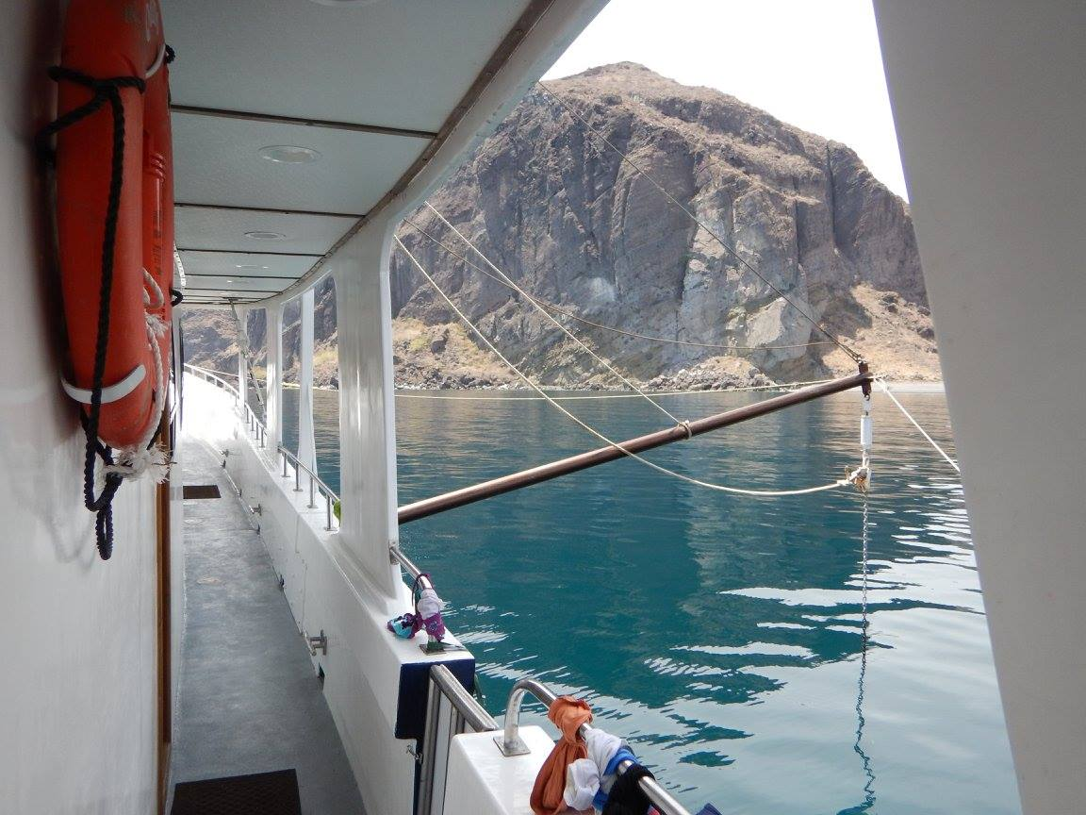

Slide 60
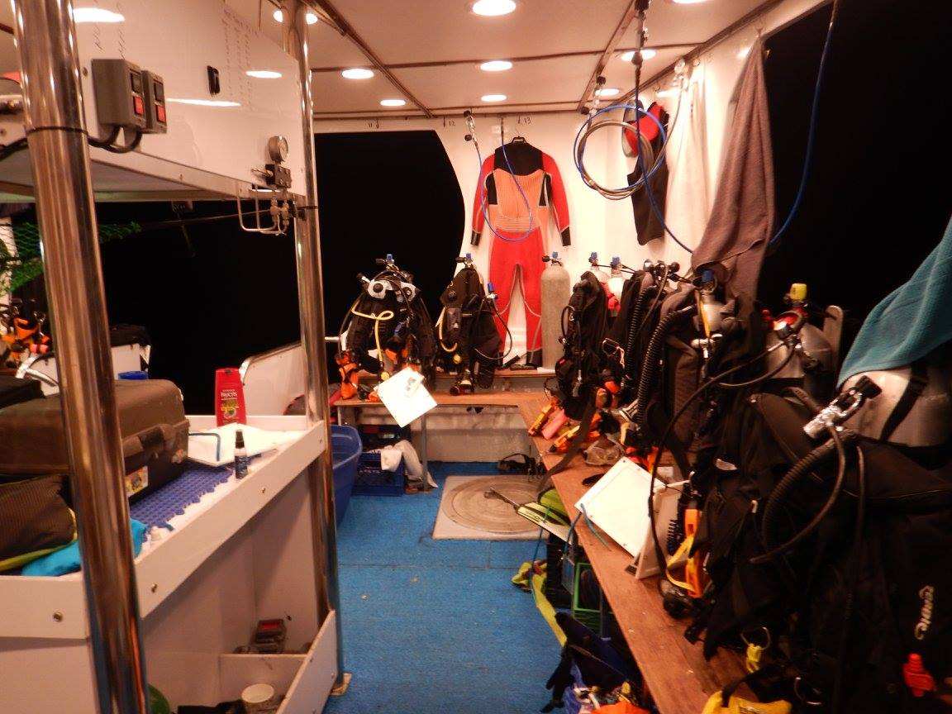

Slide 61


Slide 62
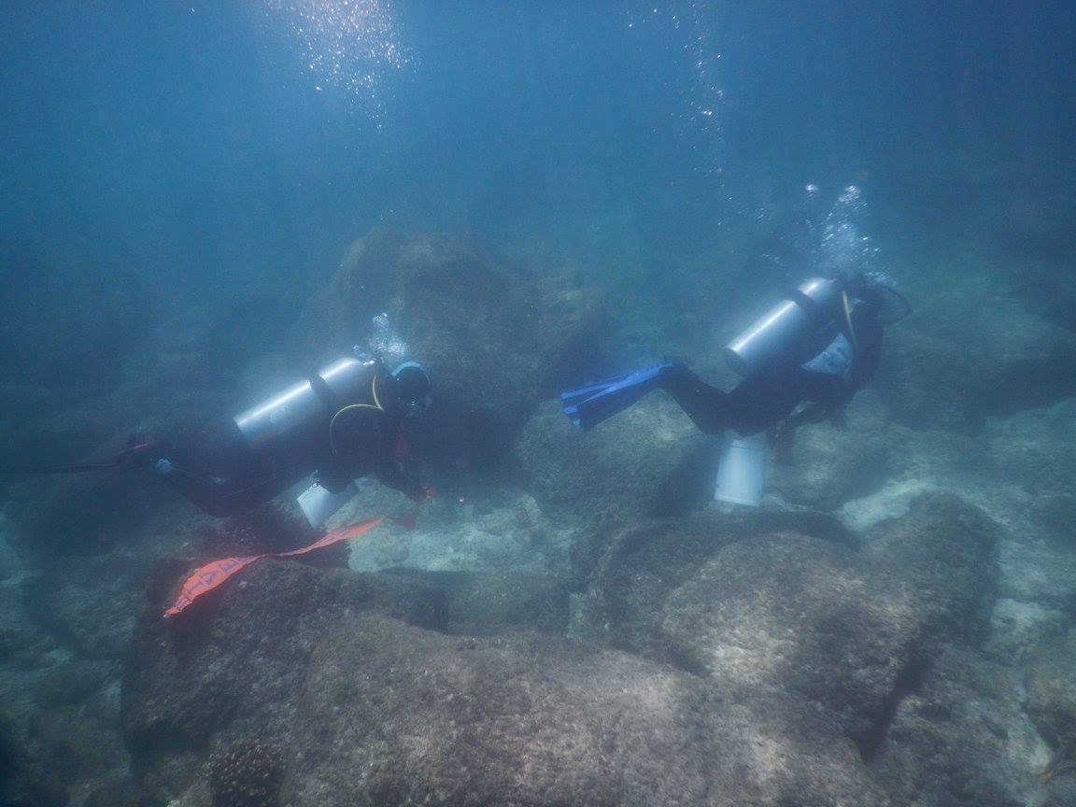

Slide 63
