Slide 1
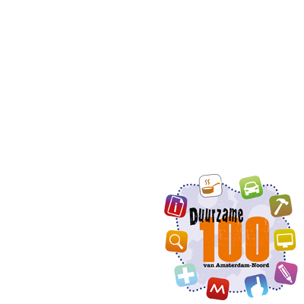
‘This is the network economy.
So.. where is the coffee machine?’
The Sustainable 100
of Amsterdam-Noord
Organising the ecosystem
Nathalie van Loon
Notes:
Hi, my name is Nathalie van Loon and I’m happy to share my story with you today about our work on circularity. Our main question is: what makes a network work? I’d therefore like to show you this short 1-minute movie:
https://www.youtube.com/watch?v=cfV1DEj09Tg
How do you make things happen in the network economy? How do you organise and facilitate cooperation?
We need a reboot to a circular economy. And where, in the old, linear, economy everything started at the coffee machine: where is the coffee machine in the network economy?
WNKL started out with this question 3 years ago. The answer: by organising the ecosystem.
There’s so many freelancers in Amsterdam: 1 out of every 10 inhabitants (including babies and elderly).
--
Vragen:
What triggered you to set up your network?
What hurdles did you need to jump in order to establish the network?
In what stage of maturity is your network now?
What do you see as the strength of your network
Where do you hope to be in 5 years’ time?

Slide 2
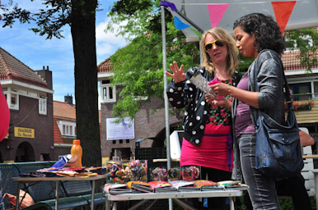
The Ecosystem
Background
Amsterdam: freelance capital
Amsterdam-Noord: very diverse/ gentrification
Opportunity
Knowledge institute
Innovation
But..
Experts don’t find each other.
WNKL
Localises knowledge and experience, brokers and stimulates to realise sustainable opportunities
Hyperlocal
Campaigning
IRL: Open Coffees, festivals, meet-ups and CoPs
Innovationlabs/ hackathon
Diverse network: everybody has his or her own (sustainable) perspective.
Notes:
What does the ecosystem look like and what do we do to organise it?
First: Amsterdam is freelance capital: 1 out of 10 inhabitants, including infants and elderly are freelancing. And the number is growing. Freelancers are a very diverse group of people: from earning more that the MP, to real poverty. Also Amsterdam-Noord is very diverse: gentrification is going fast. Where first the freelancers were the handy guys in the vans, now it’s the advisors on a bike carrying their laptops.
WNKL wants to unite this diversity and cross bridges. We’re all experts: we all love what we are doing! And in order to build a ‘local enterprise network’ or ‘coop’ you need everybody. Compare WNKL it with a multidisciplinary sustainabilty guild: both student and senior work together.
We have a tremendous opportunity with each other: just think: what AirBNB does and what all this knowledge can do when added together! Just illustrating it with the ‘Senseo effect’: this is a coffee machine that was invented by a coffee addict and technician together: you need multidisciplinarity and that’s what we’re organising!
Also, even in the same sector, people don’t know each other, or their networks.
WNKL organises and brokers. Hyperlocal: circular.
Why? We want to organise system change by starting small and bottum-up. We collaborate with ‘big’ ‘friends’ all over Noord, like the local hospital, municipality and more. We work with change agents, because they will get the ‘peloton’ moving forward.

Slide 3
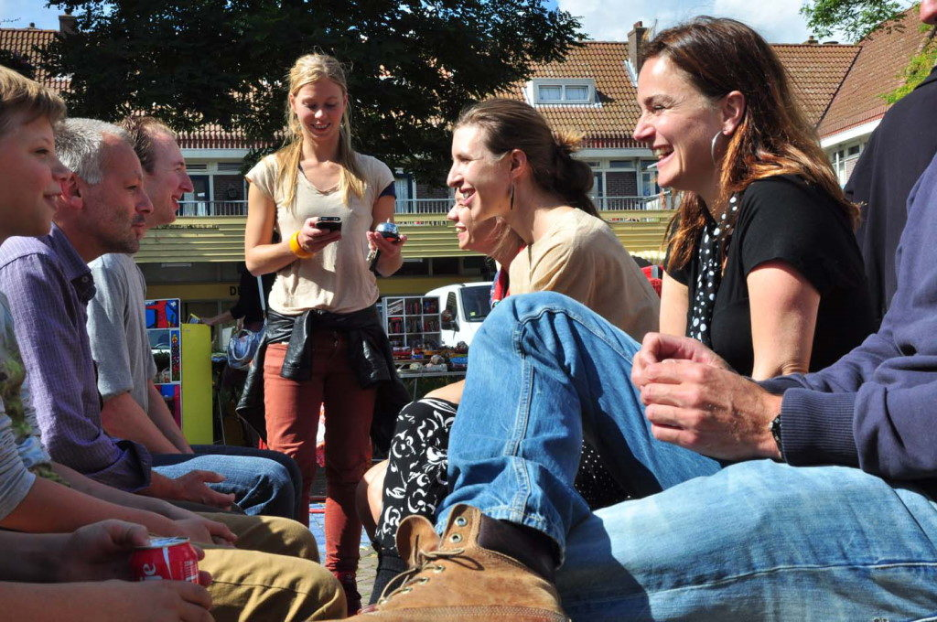
The Sustainable 100: towards a circular economy
Entrepreneurs:
Share raw materials and waste
Share assets like electrical company cars
Collaborate in energy co-ops / local smartgrids
Collaborate in sustainable offices and third places
Provide sustainable services and solutions from a local ‘network company’
Put sustainable procurement on the agenda
Innovate
Locals:
Have a sustainable alternative and know why and how to find it locally.
Procurement officers have an option to work with sustainable local co-ops
Incentive for the ‘peloton’ to work in a more sustainable way
Through campaigning, co-operation and sharing knowledge the number of frontrunners grows. From linear to circulair, hyperlocal co-operation is key.
Notes:
What’s in it for everybody? See slide.
What we do:
CoP: sharing knowledge: tremendous need! Offering sustainable perspectives for business management .
Innovation labs: local sustainable quick wins! Like the hospital: on procurement, waste, energy, food, water, local.
Campaigning: like the ‘Greenest Day of Amsterdam’ in October: local projects in cooperation.
We aim to achieve: local innovation in production, consumption and distribution and contribute to local programmes such as clean(er) air, climate proof city, circular economy, sustainable energy
We’re working on a map or other tool:
to provide sustainable options and knowledge to locals
to facilitate cooperation.
We’re looking to develop a sustainable local currency in the future, maybe working together with the energy coin foundation.

Slide 4
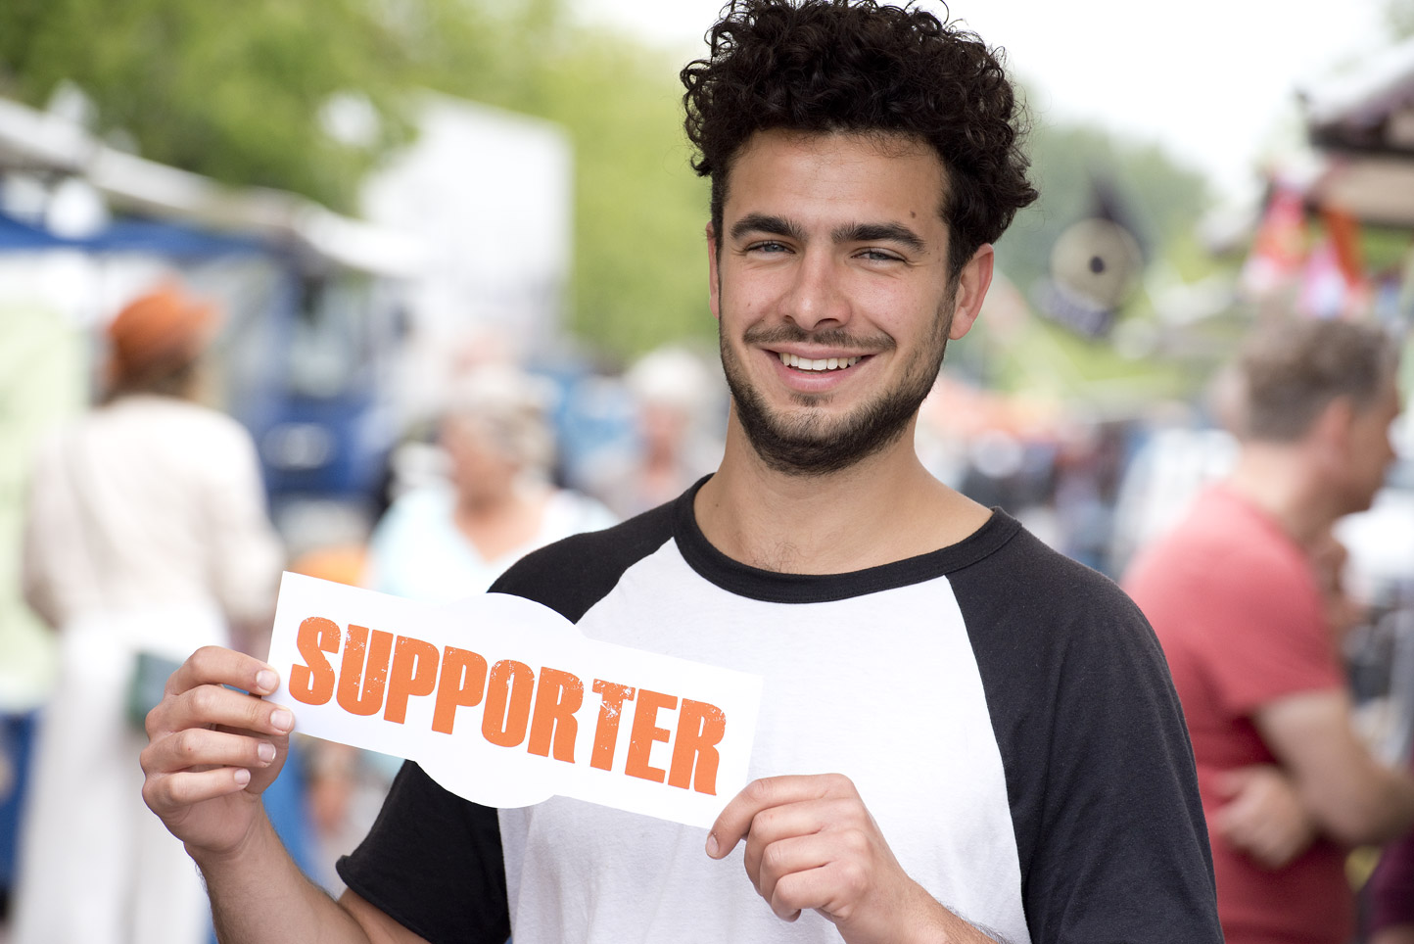
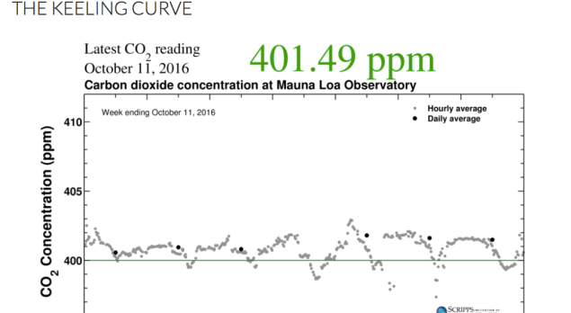
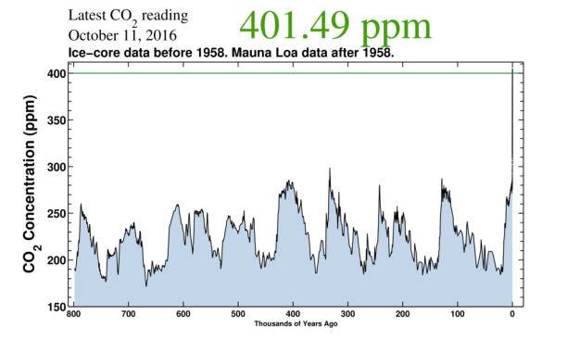
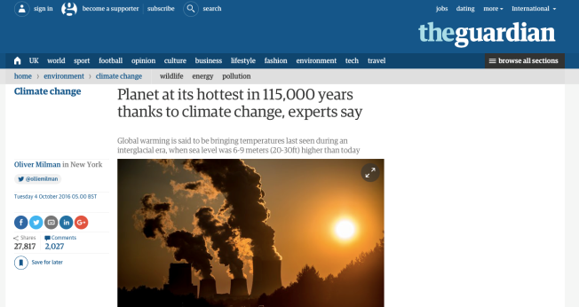
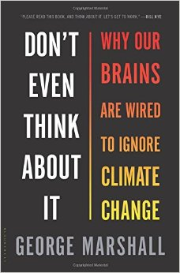
Campaigning
Climate communication:
Behaviour → Attitude → Knowledge
Local heroes & local stories
Notes:
How do we do the campaigning? Marshall: climate change exists for us in the form of social facts: socially constructed narratives based on our own values and worldview
So, although we know that we’re frying the earth (see the keeling curve), why do we keep ignoring the problem? There’s many reasons and good research on that. Most important conclusion is that identity overrides knowledge: "It’s important to realise however that many defences are not just psychological but are culturally sanctioned and socially maintained. Defences are systemic, embedded in cultural assumptions and the practices of institutions” Rosemary Randall (psychotherapeut Climate Converstations).
So, in conclusion, how do you organise a network? By sharing the same ‘locality’ and meeting eachother, having the same goal and project to work on, by sharing the ‘same’ sustainable interests and by having enough serious leisure time! → next slide

Slide 5
