Slide 1
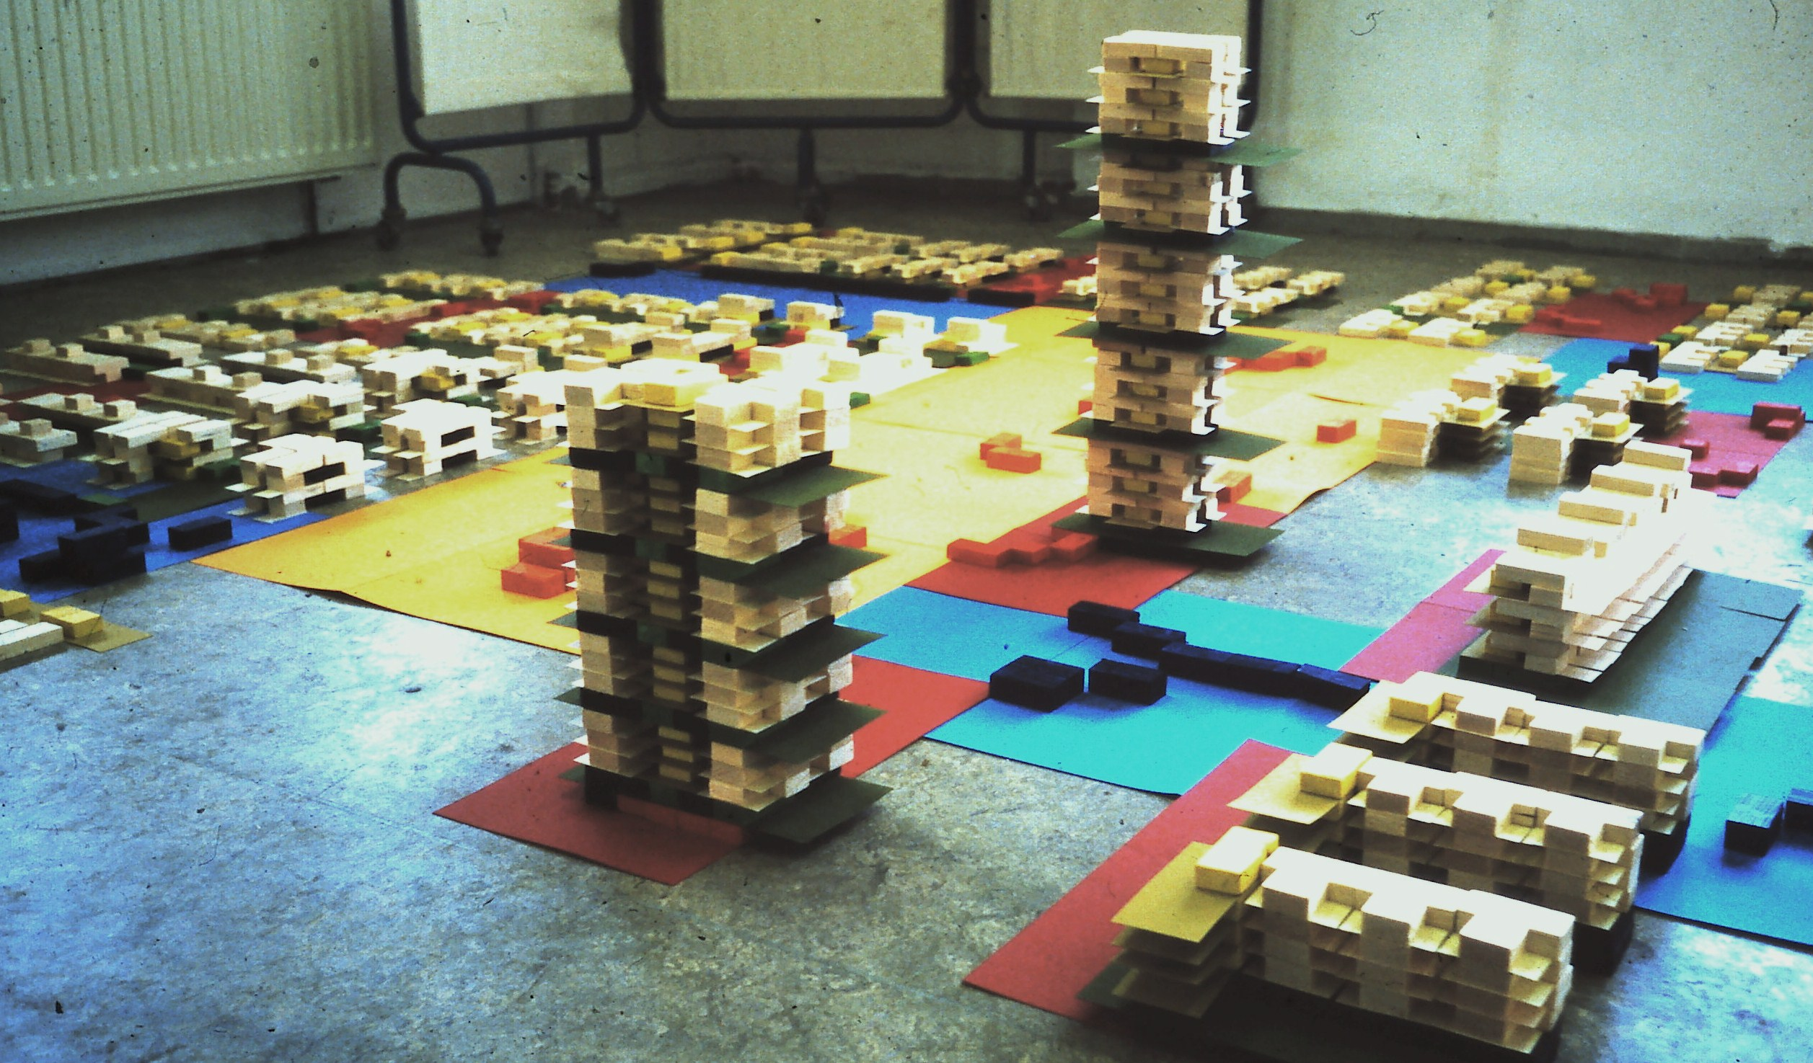
Urban Design for a Common Economy
‘Field and Volume’
-Design method
-Analyses tool
Philip Krabbendam July 2017

Slide 2
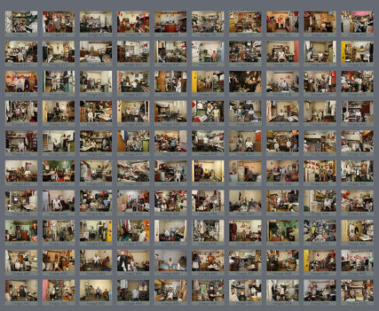
Intoduction We have a problem A huge context in which we disappear
Where am I ?
Who am I ?

Slide 3
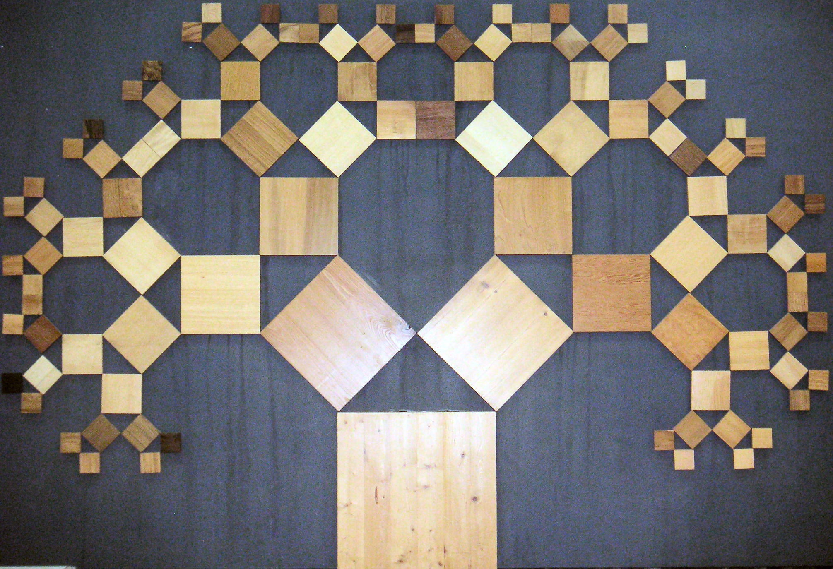
Urban tree structure can solve the problem
Tree of Pythagoras
Not urban

Slide 4
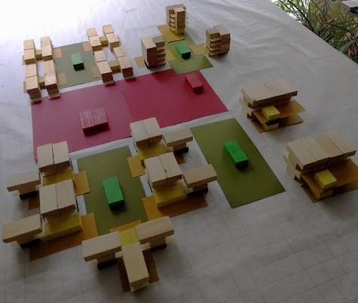
Urban tree structure at work
Each (spatial and social) level
recognizable in context next level
House
Group (cul de sac, portico)
Court (garden, almshouse)
Street
Neighbourhood
District
etc

Slide 5
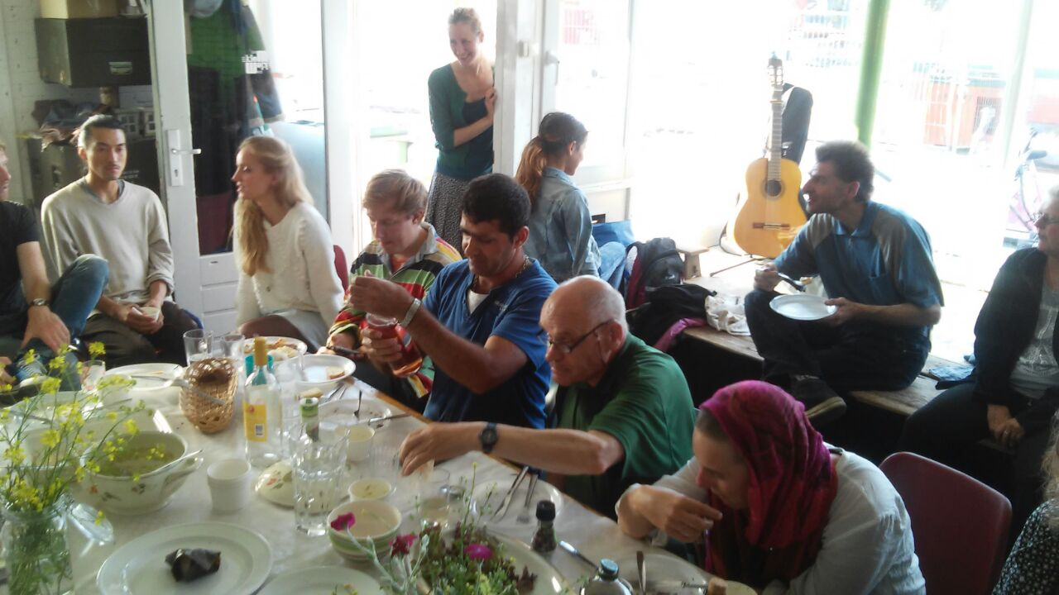
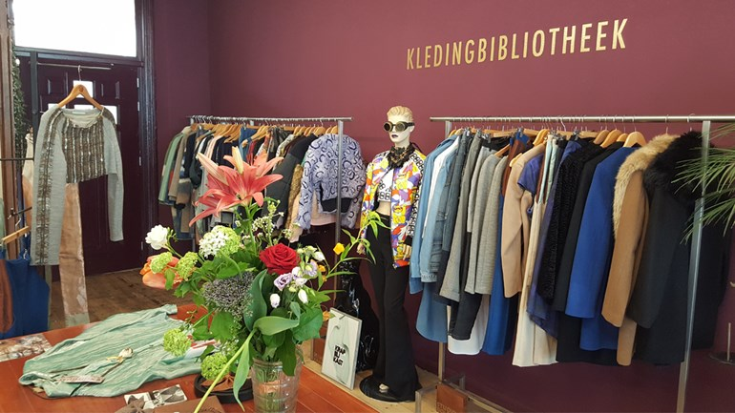
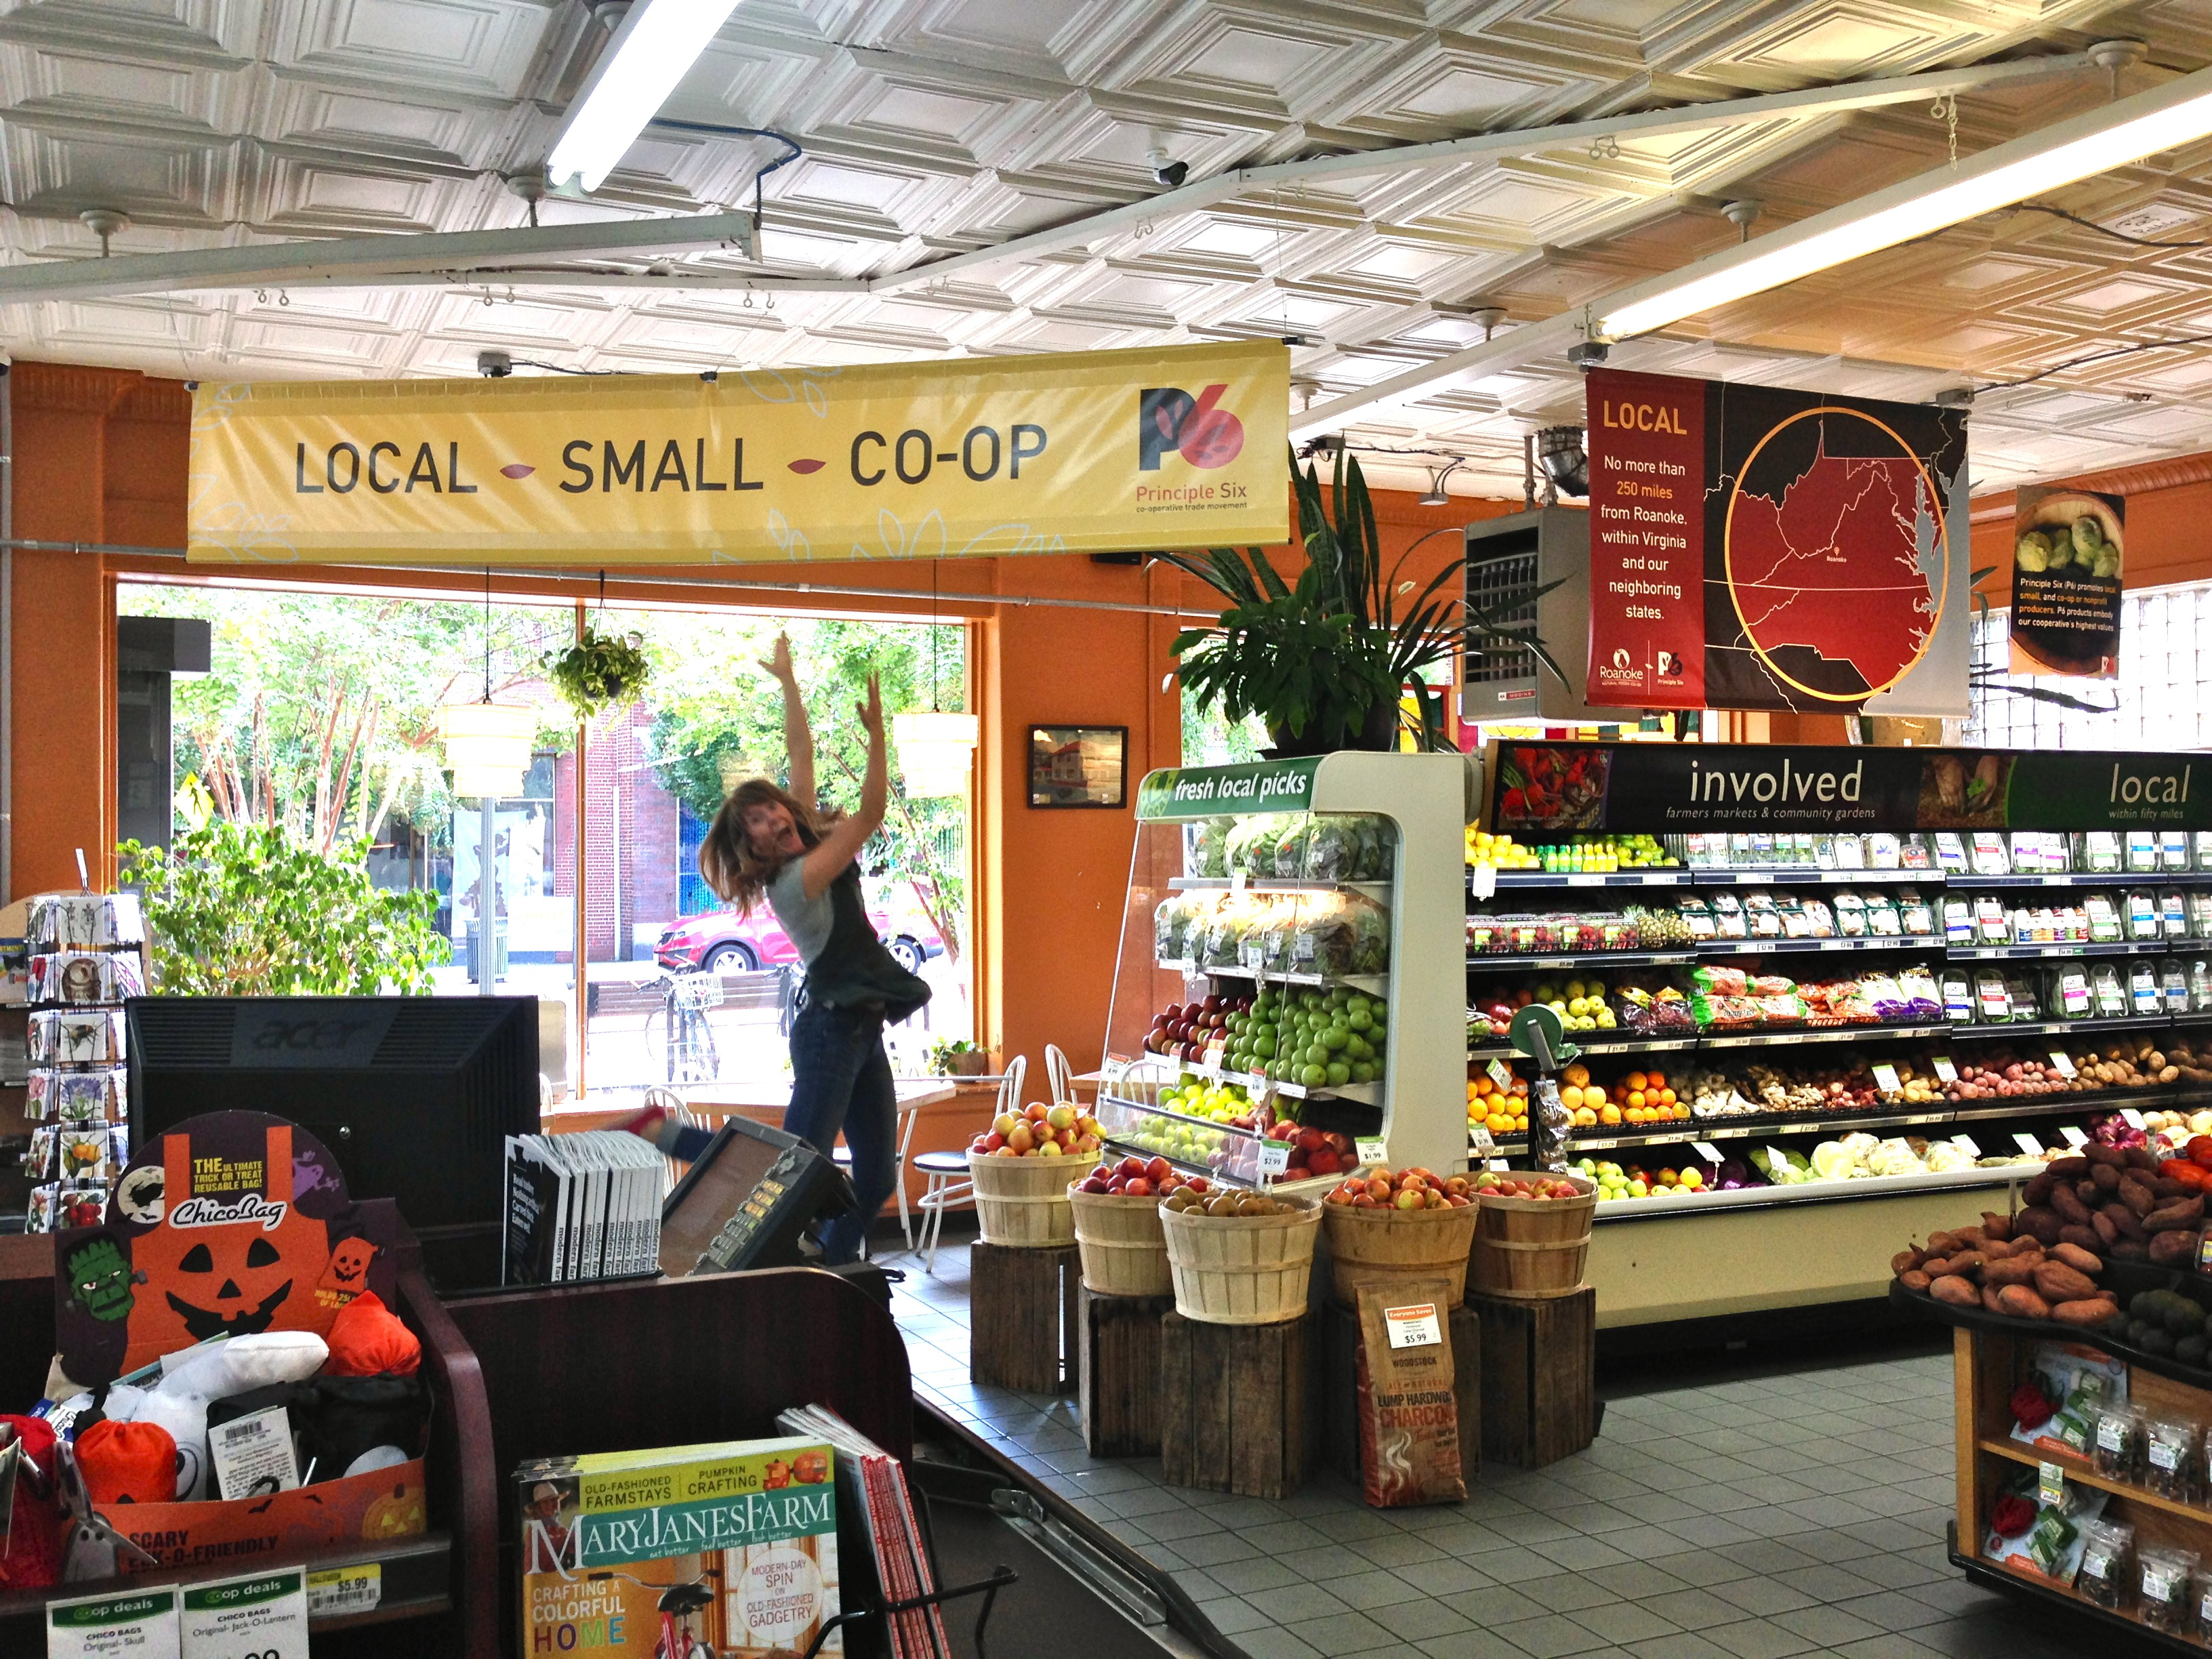
Commons
Urban tree structure evokes a social life
that is asking for common facilities
exchange between consumers and
producers
Instead of advertising and the pursuit of growth

Slide 6
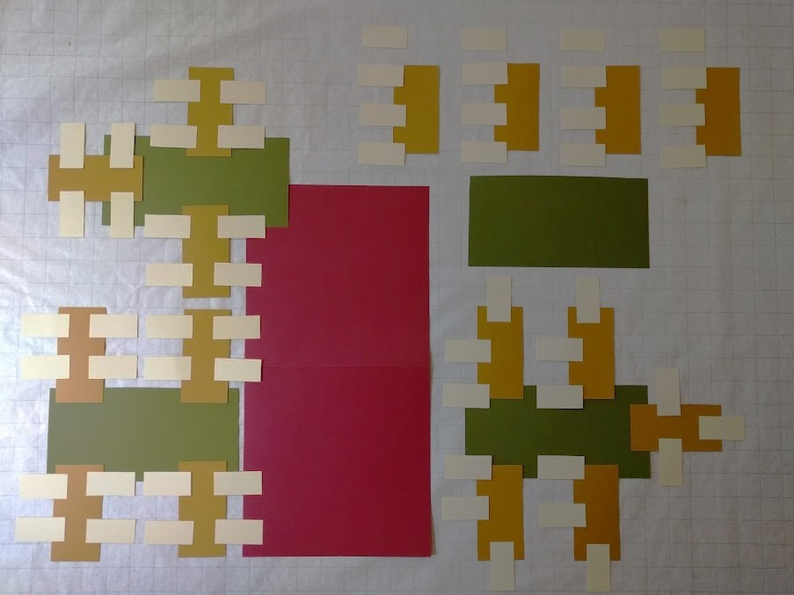
The design of urban tree structures using ‘Field and Volume’
1 Tree of fields
numbers
and configuration

Slide 7
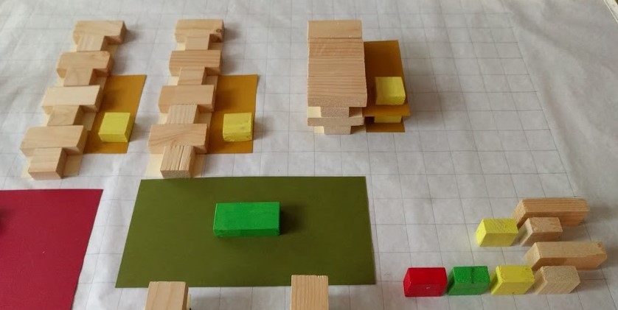
The design of urban tree structures using ‘Field and Volume’
2 Volumes
Social
and practical facilities
Stack instructions

Slide 8
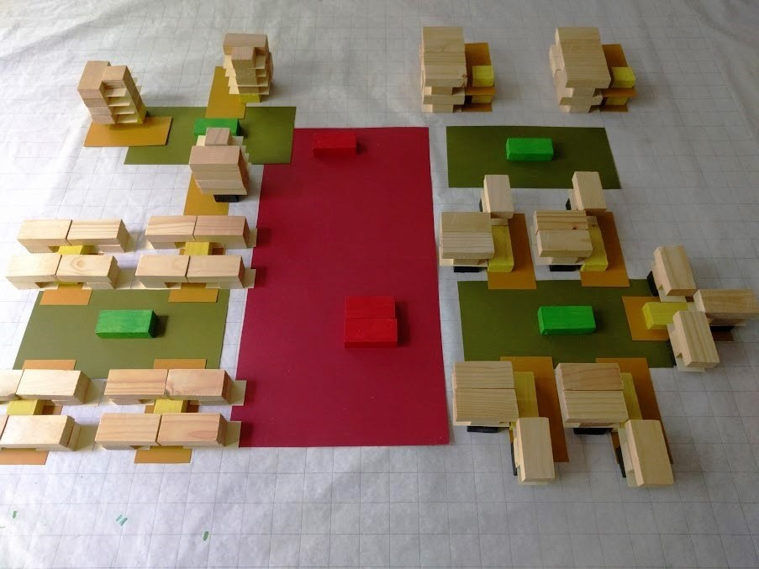
The design of urban tree structures using ‘Field and Volume’
3 basic structure

Slide 9
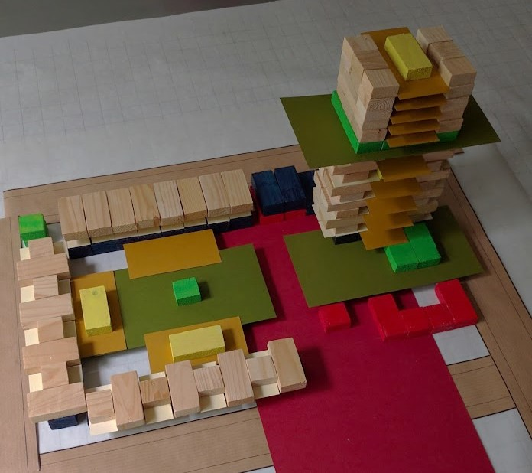
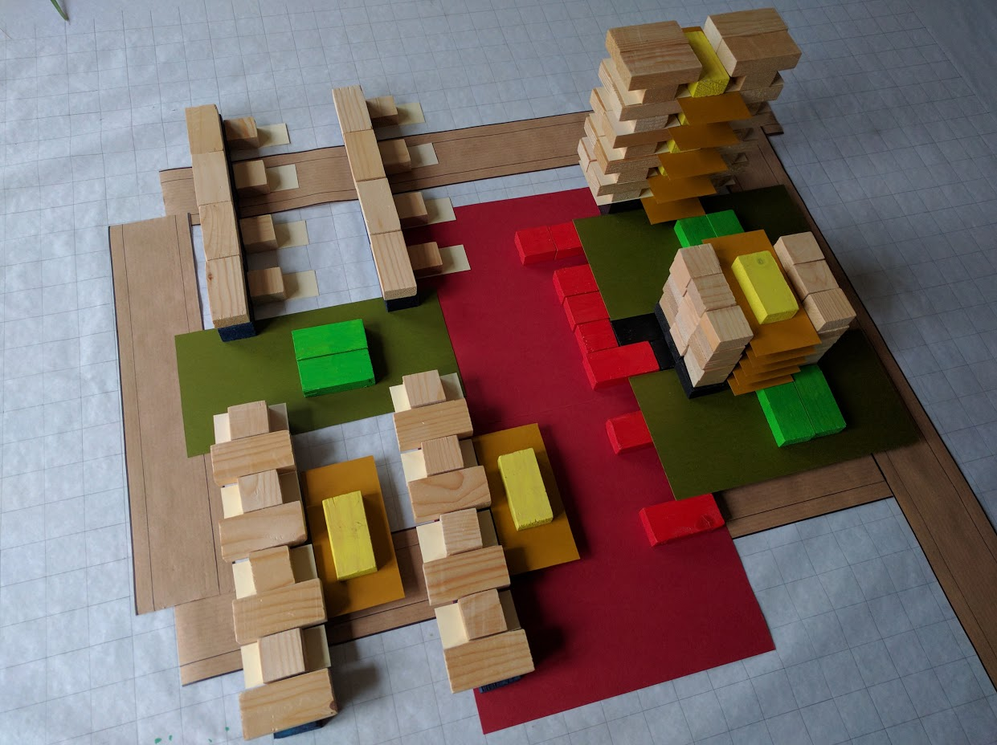
The design of urban tree structures fold to fit
3 Basic structure 4 Spatial structure

Slide 10
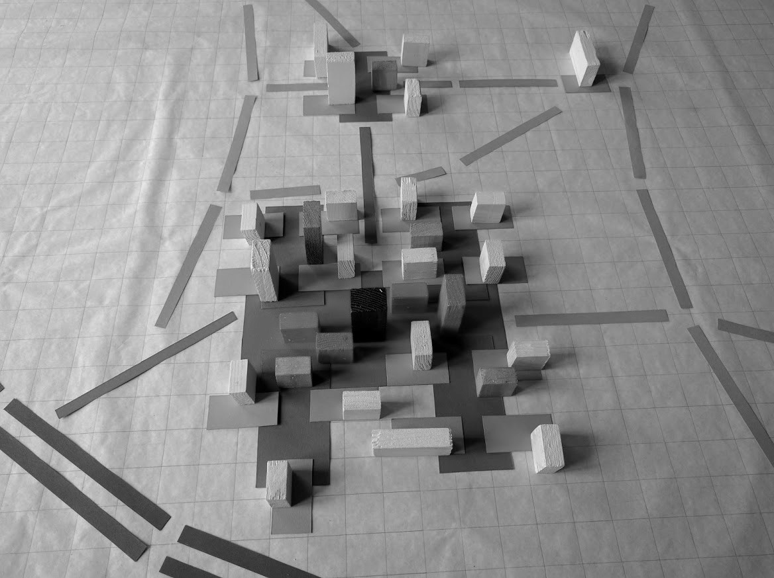
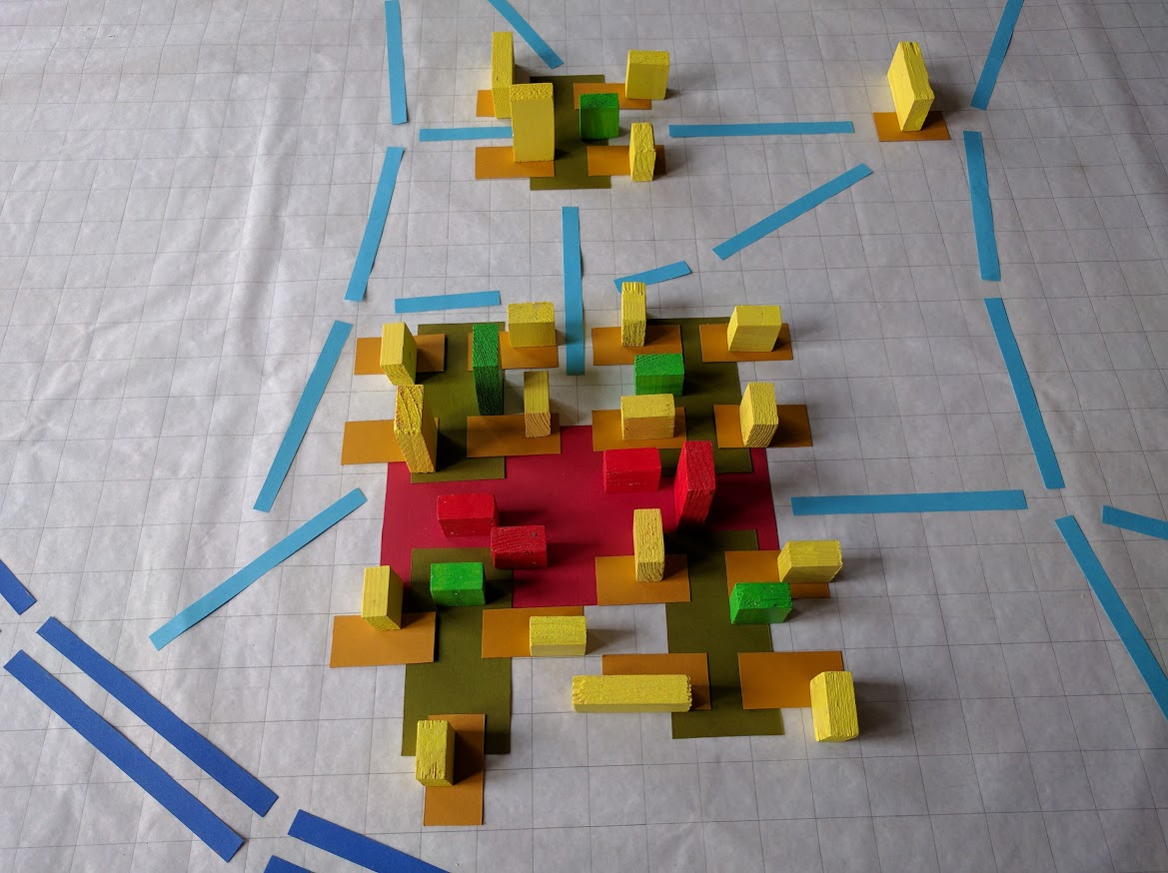
Analysis tool For recognizing scale levels
X-ray versus MRI

Slide 11
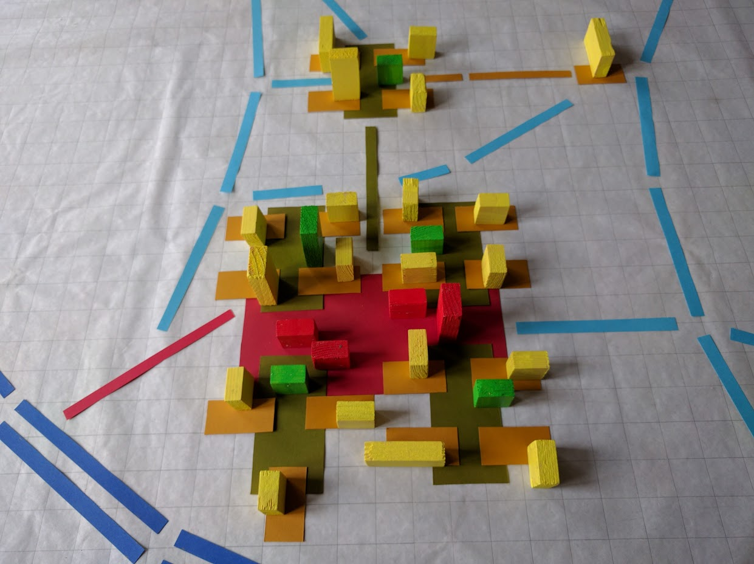
Analysis tool connecting scale levels
Loose elements Tree structure

Slide 12
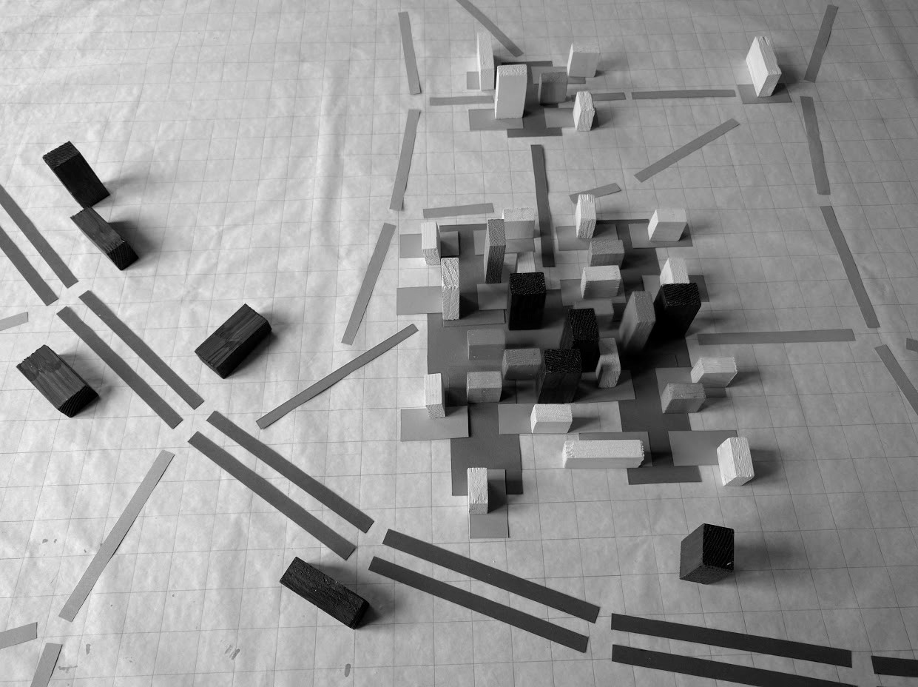
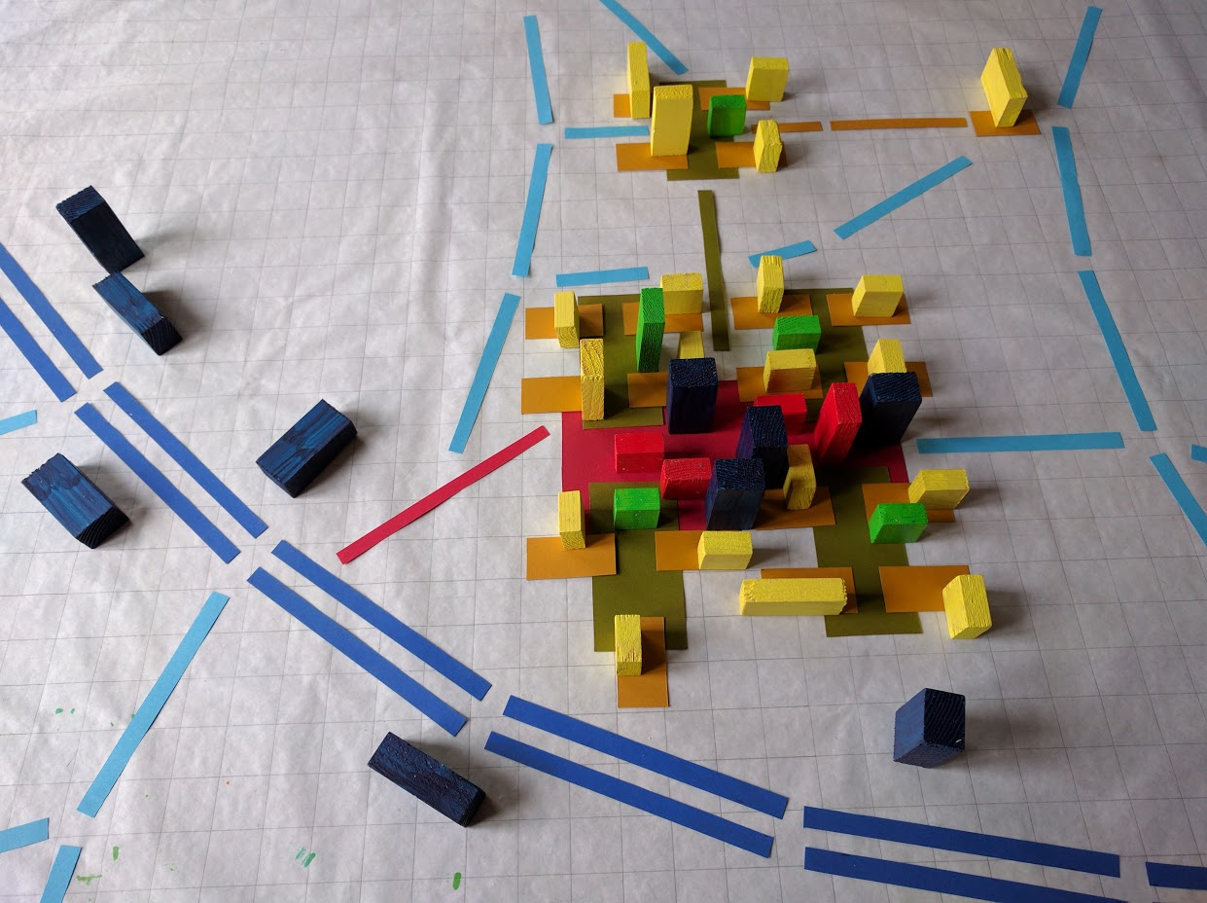
Analysis tool shows lacking scale level
X-Ray shows cluttering along motorway MRI shows lacking ‘field’ for ‘blue’

Slide 13
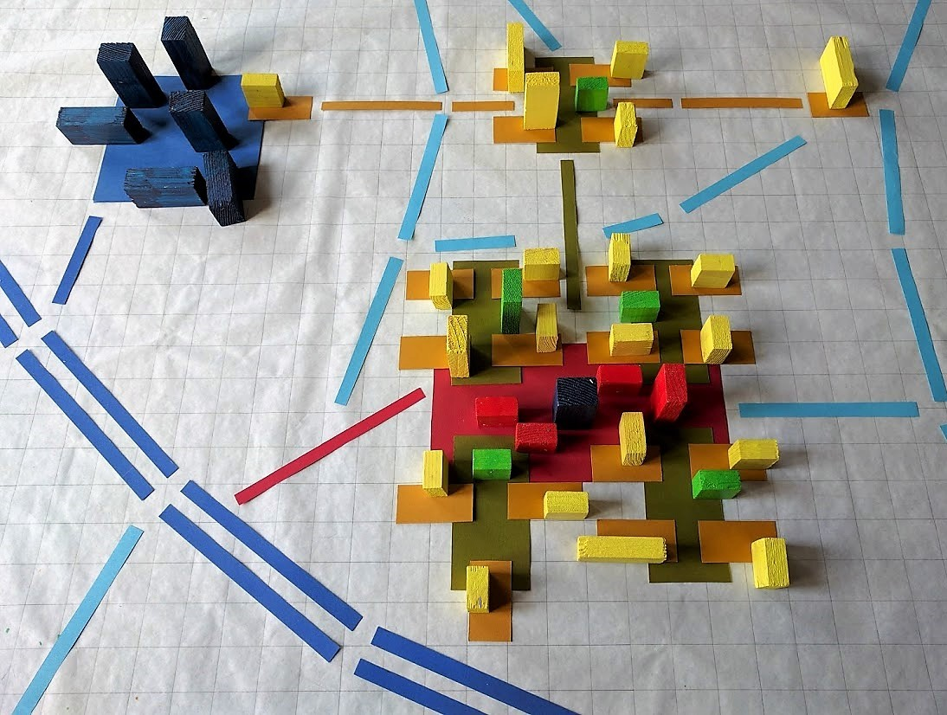
Analysis tool adding scale levels
Missing scale level Two levels added

